Slide 1
Welcome to the Circular City Labs Webinar
“Initiating Reuse – Perspectives for Businesses and Cities”

Slide 2
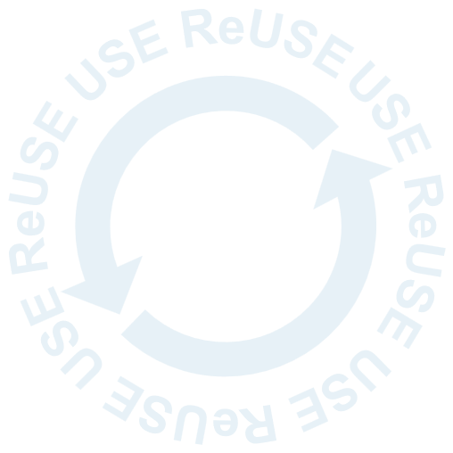
During the webinar, please:
Mute yourself.
Follow the chat for updates and use it to post questions.
Be aware that the event will be recorded.

Slide 3
Agenda
Topics | Speaker
Circular City Labs | Jana Schwalm (GIZ)
Gender perspective in the Circular Economy | Adriana Victoria Mera Sotelo (Gender Focal Point at GIZ Colombia)
Reuse businesses | Elisabeth Wohlfarth (RECUP) Eckhard von Münchow (ReFrastructure)
Roles of cities | Magashen Naidoo (ICLEI) Tobias Staufenberg (City of Tübingen)
Next steps | Jana Schwalm and Angelina Schreiner (GIZ)

Slide 4
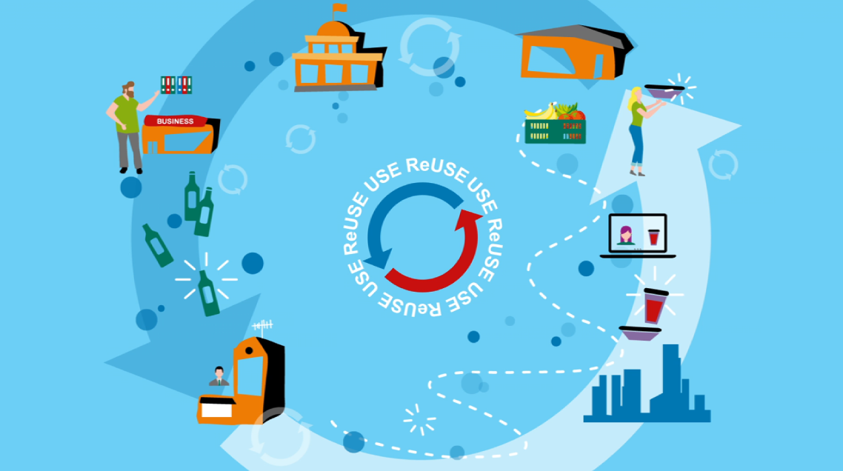
Click here to watch our video on reusable packaging systems and the Circular City Labs project

Slide 5
Circular City Labs Testing reusable packaging in cities
Jana Schwalm (GIZ)

Slide 6
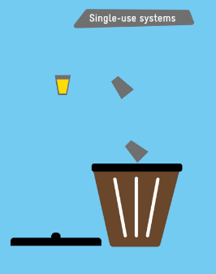
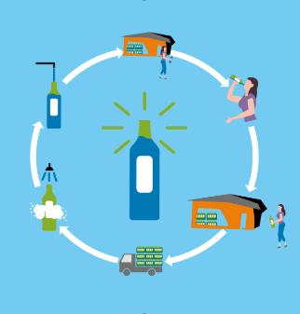
Reusable packaging
Circular approach
Packaging can be cleaned, refilled and used repeatedly for same purpose
Small deposit is added to incentivize the consumer to return
After consumption, the consumer returns the empty container to collection point to get deposit back
Reusable packaging systems can also be set up business-to-business
Notes:
Skippen, wenn Video funktioniert hat

Slide 7
Circular City Labs – Testing reusable packaging systems in cities
Project goal: Reduce greenhouse gas emissions through waste prevention.
Reusable packaging systems are tested.
The participation of women in the local circular economies is strengthened.
Project period: 01/2023 to 12/2025
4 selected partner cities: Tirana (Albania), Tbilisi (Georgia), Medellín (Colombia), South Africa or Kosovo (tbd)
Sectors: Selection of sectors depends on local demand and interest

Slide 8
Content of the Circular City Labs project
Design might differ from city to city
In each selected city:
Multi-stakeholder approach
Inviting public sector, academia, civil society and private entities
Exchange around CE, reuse and women’s participation in the economy
Collaboration with public sector
(municipalities)
Collaboration with private sector
(SMEs)
Trainings
Local-level incentives on CE and reusable packaging
Accelerator programme
Target group
14 SMEs
70% women participation
Awareness raising measures
Notes:
Lab = collaboration with public & private sector: Accelerator adresses private sector, everything else will be planned with public sector depending on their needs (e.g. consultation)

Slide 9
Accelerator Programme
Design might differ from city to city
Call for applications
Start of labs
Trainings
Development of implementation plan
Coaching sessions
Pilot implementations
Selecting best proposal and implementation plan
1 woman-driven business supported to pilot reuse business model
Evaluation & Dissemination
Evaluation
Sharing results & learnings
Identification of long-term financing
End
Estimated timeplan
4 months
8 months
02-03/2024
04/24
08/24
03/25
05/25

Slide 10
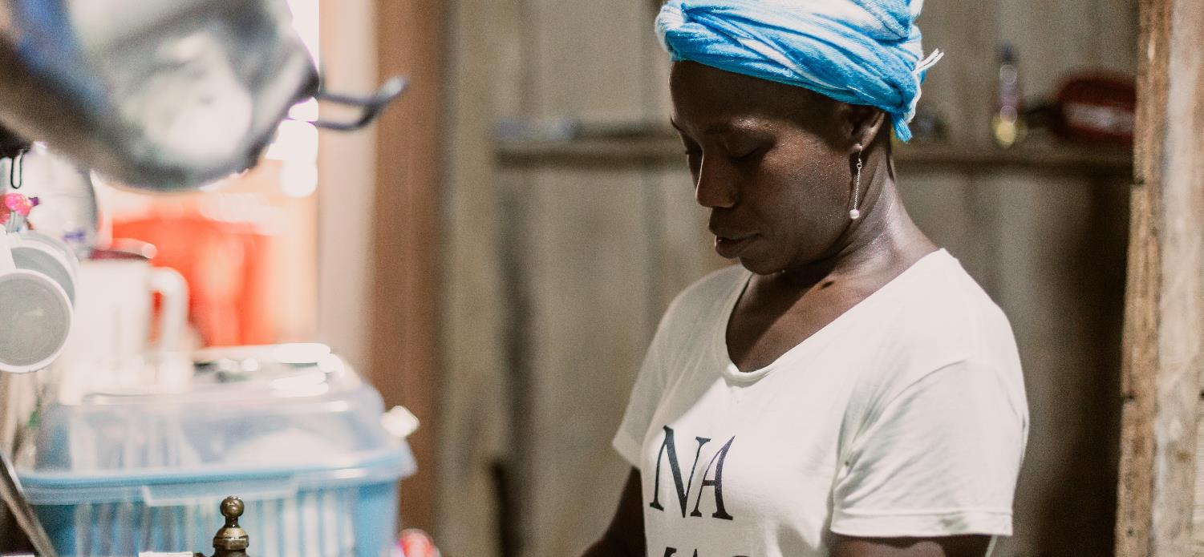
Gender perspective in the Circular Economy
Adriana Mera (Gender Focal Point GIZ Colombia)

Slide 11
Some Context
“Engaging women in the circular economy – raising awareness on sustainable consumption and encouraging participation in leadership and managerial roles – is indispensable to create good circular systems”
According to the OECD women are differentially affected by both sustainable and unsustainable production and consumption patterns because:
Are dependent for subsistence on strained natural resources.
Are affected by poor labor conditions in a “feminized” workforce.
Provide a large amount of informal and unpaid work related to waste management.
Are involuntarily and without their knowledge exposed to harmful products and chemicals.
Studies* confirm that women has low representation in industrial eco-design and advanced technology-related professions and in senior management roles.
*Manuel Albaladejo (2022)

Slide 12
Why is a Gender Perspective important in Circular Economy?
“Gender equality is a central pillar for achieving sustainable development, which is the circular economy’s ultimate aim”
The circular model can be seen as a tool to achieve SDGs:
SDG 17: Sustainable Development
SDG 5: Gender Equality
According to a 2020 study* companies with improved gender diversity on boards were to reduce:
60% the intensity of energy consumption
39% GHG emissions
46%water use respectively
*Period 2013-2018
If the circular economy is to be a game changer for production and consumption patterns, it must do so based on principles of equality.
Circular Economy is still overwhelmingly male-dominated: women make up only:
5% of executive board members;
21% of non-executive board members
15% of senior management leadership roles.

Slide 13
Main Obstacles for Leadership of Women in the Sector
Gender dimensions of the circular economy faces the following challenges:
laws, policies, regulations, and institutional practices as high taxes, lack of government incentives and subsidies to small businesses.
cultural norms and beliefs.
gender roles, responsibilities, and time use.
access to and control over assets and resources.
patterns of power and decision-making.
lack of information on available business education, training programs, and technical support for entrepreneurs.

Slide 14
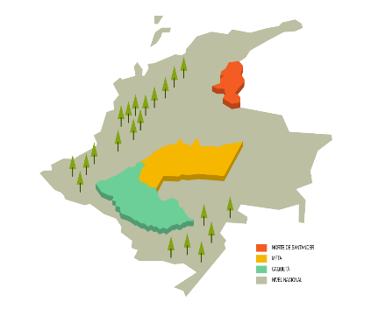
The Case of Colombia
National Circular Economy Strategy (ENEC) :
Strategy to retain the value of materials;
Alternative to prevent the generation of waste and reduce the consumption of single-use plastics.
A research of GIZ* about circular economy in 4 cities in Colombia, shows women have participation of:
69% in jobs
74% in management positions
70% in the ownership of reuse initiatives
Bogotá, has “Bogotá Circular” strategy, along and coordinated with stakeholders from different sectors of society.
43.8% of female entrepreneurs in Colombia exhibited entrepreneurial
intentions, but only 4.9% of them ran established businesses (2018).
*Circular Economy in Colombia (giz.de)

Slide 15
Final Reflection
How can a circular economy prevent gender disparities from the transition stage?
How to account for and address the practical and strategic needs of women?
How to ensure the active inclusion of women in circular-economy-related activities?
It is imperative to systematically incorporate a gender lens in circular economy design since it requires understanding consumer behavior and local/ traditional sustainable practices, which are domains where women are often the knowledge holders. Investigating “gender roles and behavioral preferences in consumption as well as waste generation and prevention” could lead to addressing gender inequalities “through recognizing the value of jobs supporting circular economies” (OECD, 2020).

Slide 16
Reuse businesses
Elisabeth Wohlfarth (RECUP)
Eckhard von Münchow (ReFrastructure)

Slide 17
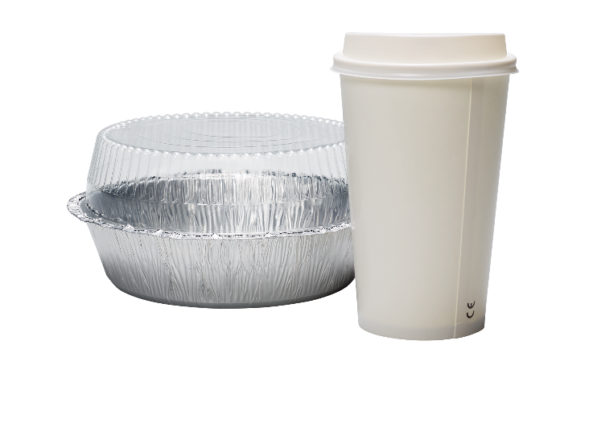
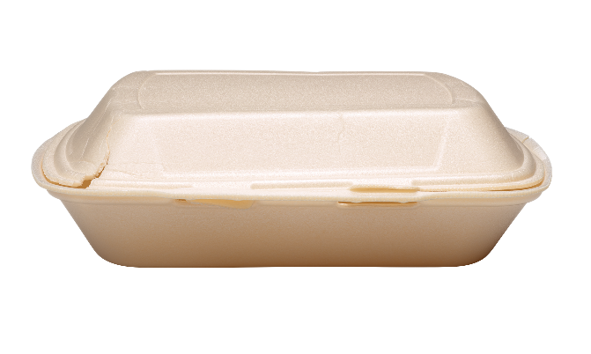
13 Billion
single-use packaging items are yearly used and thrown away in Germany.
Notes:
Lässt man diesen Ticker ein Jahr laufen, sind wir bei 13 Milliarden Verpackungen in Deutschland.
Wir haben es uns zur Aufgabe gemacht, diese Zahl zu senken und etwas gegen dieses rasante Steigen zu tun.
Deutschland
13 Container per person per month in Germany

Slide 18
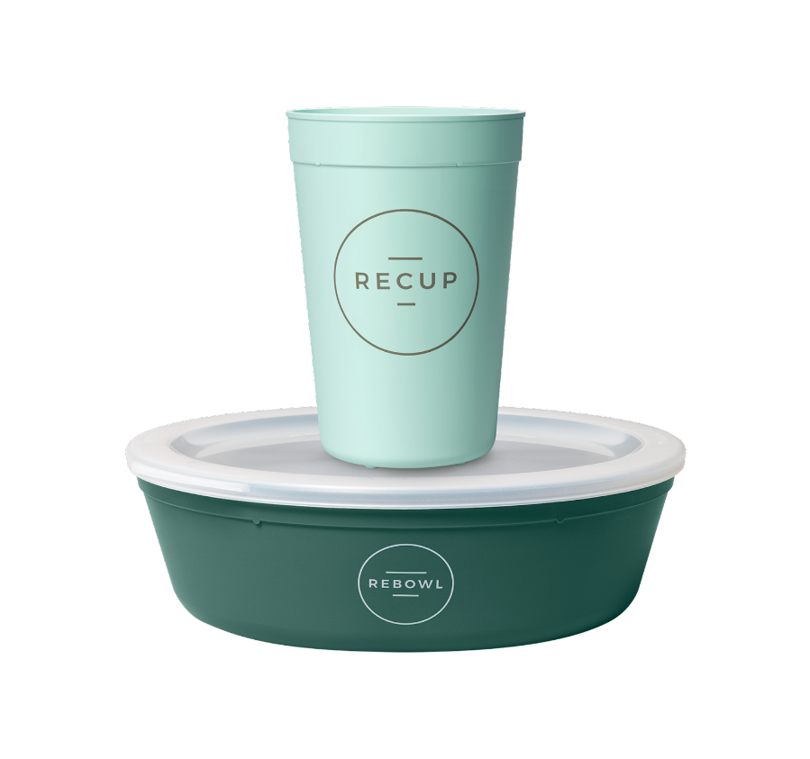
Notes:
ja, warum nicht?!
das ist sie: unsere Veränderung.
dieser Becher und diese Bowl sind entstanden - mit kleinen und großen Hürden, mit Veränderungen in Form und Farbe-
die Idee dahinter: Ganz einfach - Mehrweg statt Einweg

Slide 19
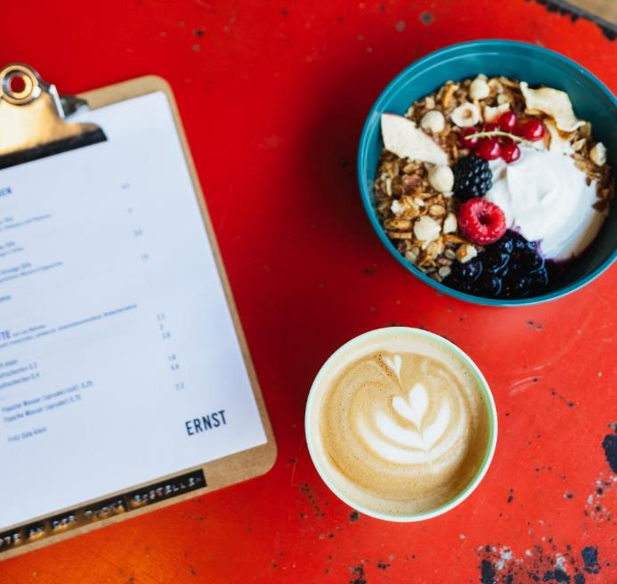
Comparison reuse systems
Availability: one store, chain or city, a shared pool of several chains, nationwide or international
Business Model: Pay-per-use, membership payment
Handling: analog (deposit) or/and digital (penalty system)
Products: shape, size, material, diversity
Notes:
Und dass das System einfach funktioniert, beweisen auch mittlerweile über 12.000 Partner - deutschlandweit und flächendeckend. Darunter finden sich große namhafte Unternehmen im Tankenstellenbereich, in der System- und Betriebsgastro oder im Bäckerei-Bereich. Und natürlich sind auch ganz viele inhabergeführte Restaurants, Cafés, Metzgereien oder Bäckereien. Das zeigt einfach, dass unser System für eine Vielzahl von unterschiedlichen Gastronomiebetrieben funktioniert.
Wir arbeiten natürlich auch mit den gängigsten Lieferdienst-Anbietern zusammen, um Mehrweg so komfortabel wie möglich zu machen.
Außerdem stehen wir aktuellen mit über 120 Kommunen, Landkreisen und Städten im Austausch, um Mehrweg in den jeweiligen Regionen voran zu treiben.
Panelty System

Slide 22
Monthly fixed payment
independent from order volume & daily usage
all products
deposit is not real cost
after break even point cheaper than single use
Notes:
Ich möchte auch noch einmal betonen, dass es sich bei dem monatlichen Nutzungsbeitrag um Fixkosten handelt, das heißt Ihr habt jeden Monat die gleichen Kosten, egal welche Mengen an Bechern und Schalen Ihr verwendet und könnt mit diesen Kosten planen und kalkulieren.
Es ist zudem ein zwei für eins System, das heißt, Ihr selbst könnt entscheiden, ob Ihr nur RECUP oder nur REBOWL oder beides nutzen möchtet. Auch hier bleibt der monatliche Nutzungsbeitrag von ca. 1€ am Tag immer gleich.
Das Pfand ist ein durchlaufender Posten, das heißt, Ihr hinterlegt einmal das Pfand bei uns, wenn Ihr Euch Behälter bestellt, gebt dieses Pfand aber 1 zu 1 an eure Kundschaft weiter. Beispiel: Ihr leiht Euch von uns 100 RECUPs, dann sind das 100 Mal 1€, die Ihr bei uns hinterlegt, Ihr erhaltet diesen 1€ jedoch im täglichen Geschäft von Eurer Kundschaft wieder, wenn Ihr die Becher ausgebt.
Zudem habt Ihr kein Risiko, denn das Eigentum der Behälter liegt zu jedem Zeitpunkt bei RECUP, das heißt, wenn Behältnisse kaputt gehen, könnt Ihr diese an uns zurückschicken, wir erstatten das Pfand und Ihr könnt Euch neue Behältnisse im Shop bestellen.
Nachhaltiges Geschäftsmodell: Motivieren, Incentivieren mehr Mehrweg zu nutzen, und damit Mehrweg noch attraktiver und günstiger zu machen

Slide 23
20.000+ partners in the network
Small & big.
Active cities
RECUP/REBOWL partner
Notes:
dann kam das Gesetz und das ist erstmal sehr positiv und etwas worauf wir lange hingearbeitet haben:
neue Gesprächsgrundlage: so gut wie alle MÜSSEN sich jetzt mit Mehrweg auseinandersetzen
Die großen Player entscheiden sich
Welle an neuen Partnern
Das Thema Mehrweg und Einwegmüll ist immer mehr Teil des öffentlichen Diskurses
Unser Netz wächst und wächst und wird somit für Anbietende wie auch Endverbraucher:innen immer zugänglicher.
Aber auch Wachstumsschmerzen:
Welle schwer einplanbar
Große Lagerbestände
Immer mehr Anforderungen an Produkte und System

Slide 24
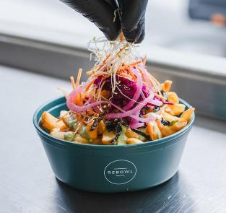
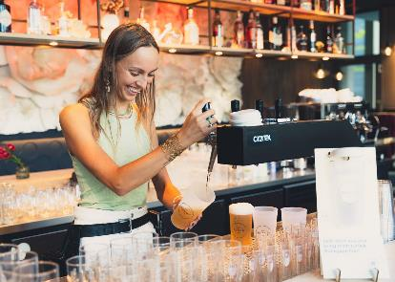
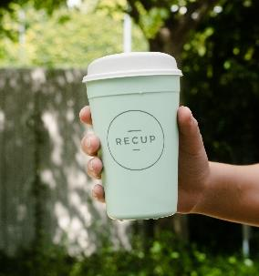
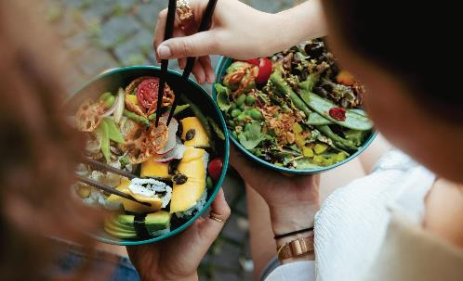
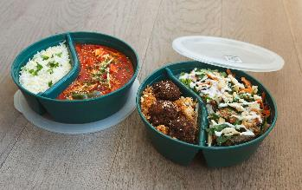
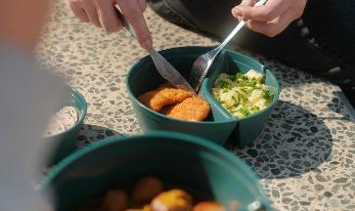
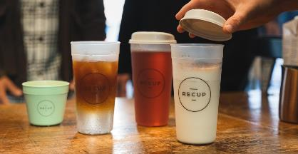
Notes:
Und wie schön es aussehen kann, Mehrweg zu nutzen und wie viele verschiedene Gerichte und Getränke in unsere REBOWLs & RECUPs angerichtet werden können, hab ich Euch hier mitgebracht.

Slide 25
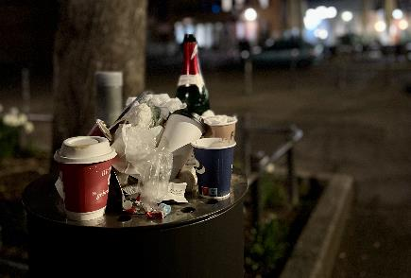
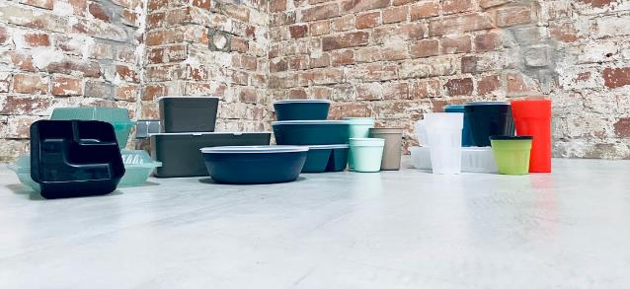
ReFrastructure Foundation -
the Digital Infrastructure for Reuse Systems

Slide 26
Current reuse systems face problems
X
Reusable tableware has to be returned to the respective partners
Too few return points
End customer
Reuse system start-up
On its own, each system has too low volumes to run cleaning and logistics economically
No central cleaning facility
X
Restaurant operator
Foodtruck operator

Slide 27
ReFrastructure Foundation enables “Return Anywhere” - a broad return network for all reusable containers.
Benefits for citizens: Convenient return of reusable containers
Our digital platform enables a cross-system infrastructure for logistics and cleaning.
Benefits for restaurants & Co: Convenient way to offer reusable containers
Our USP: As a neutral non-profit platform, ReFrastructure Foundation enables cooperation between all stakeholders, including competitors. Scaling effects will be reaped without creating monopolistic structures.
Benefit for everyone: Economies of a common-good platform

Slide 28
How REFRASTRUCTURE works in practice
Decentralized dispensing & return
Centralized return
1.
↔
2.
A digital twin is created of each container
Logistics
API*
API
Logistics
API
API
3.
By scanning each ID, tracking of containers and deposit clearing between system participants is made possible via interfaces and our digital platform.
Anonymized data collection & analysis for logistical optimization, leveraging of synergies (logistics/ washing) & compliance with legal requirements (reporting obligation)
Cleaning
*Application Programming Interface

Slide 29
Neutrality is based on our legal format and IT-system architecture
Infrastructure & clearing system is neutral and cannot be sold.
TRUSTED BROKER
Legal format: Foundation
Technical design maintains data sovereignty of stakeholders
ReFrastructure

Slide 30
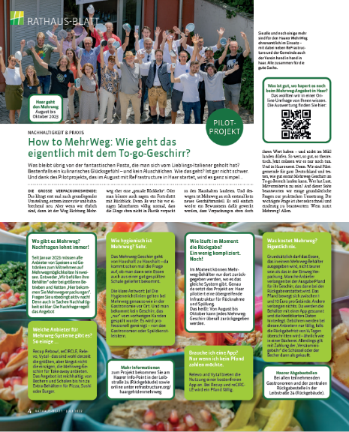
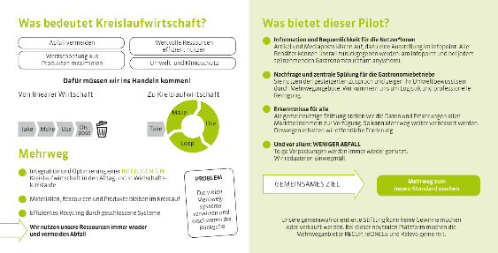
Pilot in Munich/Haar - Awareness

Slide 31
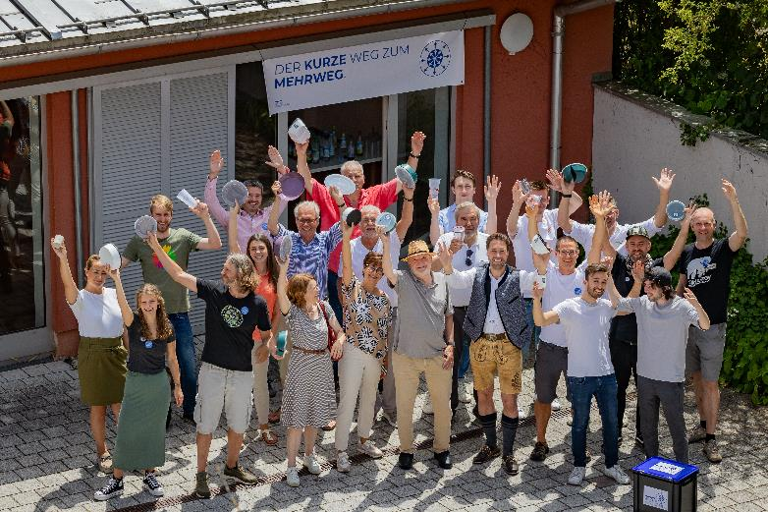
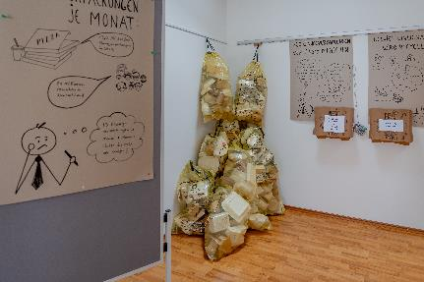
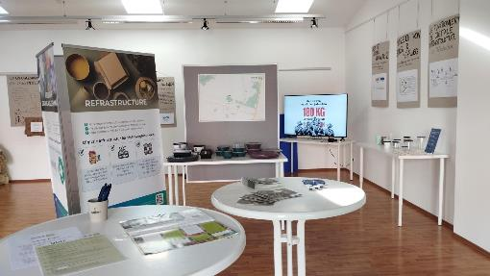
Pilot in Munich/Haar - Infopoint

Slide 32
ReFrastructure pilot – some learnings
Information campaign is crucial professional design + personal interaction select appropriate communication channels for target audiences
Digital infrastructure did work – scanning and database professional SW development with student support saves funds invest in initial case studies
Institutional support (here municipality Haar) opens many doors
Reuse is not inherently attractive – neither for gastronomy nor for users hen/egg issue: little user demand <-> limited offers
Voluntary work can start a lot – difficult for long-term processes
Project courage pays off - “Can do” proof opens new opportunities - scaling from Haar (23,000 citizens) to Stuttgart (630,000) - extension from take-away to e-commerce

Slide 33
Time for Questions!
With Elisabeth Wohlfarth (RECUP)
and Eckhard von Münchow (ReFrastructure)

Slide 34
Role of Cities
Magashen Naidoo (ICLEI)
Tobias Staufenberg (City of Tübingen)

Slide 35
Circular City Labs - Webinar
“Initiating Reuse - Perspectives for Business and Cities”
“The role of municipalities to promote and enable reuse models: Policy and holistic considerations”
Magash Naidoo, 16/01/2024

Slide 36
Our Mission
ICLEI – Local Governments for Sustainability (known as “ICLEI”) is a global network working with more than 2,500 local and regional governments committed to sustainable urban development. Active in 125+ countries, we influence sustainability policy and drive local action for low emission, nature-based, equitable, resilient and circular development.
2,500+ LOCAL
AND REGIONAL GOVERNMENTS
ACTIVE IN
125+ COUNTRIES
600+ EXPERTS IN
27 OFFICES WORLDWIDE

Slide 37
ICLEI Offices Around The World

Slide 38
Role of cities?
Integration: Critical but complex to balance multiple objectives over many thematic areas, e.g. banning single use items vs. unemployment and livelihoods.
Enabler: Primary power lies in Regulatory environment, Policies, By-laws, Strategies and Plans. Not forgetting the ability to institute incentives and enforcement mechanisms. E.g. Integrated Solid Waste Management Plans that move towards zero-waste; implementation of separation at source infrastructure and enforcement of proper use.
Conduit: Legitimate lobby power with other key stakeholders, e.g. national government to institute laws that promote Reuse; and contribute to Global Treaties.
Convener: A safe platform for all perspectives to be shared and objectives achieved for the greater good.
End-user: City Administrations also consumer a lot.

Slide 39
Circular Economy Policy Tool Box
Local governments’ instruments to build a sound policy framework to further circular economy and reuse measures include:
REGULATORY AND PLANNING
Regulations and strategic plans
Monitoring and enforcement
Environmental assessment and permits
Spatial planning
Strategic plans
Multi-level governance
Asset management
ECONOMIC
Fees and user charges
Certificate trading
Public procurement
Financial support
Investment programs
Public-private partnerships
Tax incentives
COOPERATION
Voluntary agreements
Technology transfer
Partnerships for knowledge development
Provide access to space and noneconomic resources
EDUCATION & KNOWLEDGE
Communication and awareness campaigns
Education and curriculum
Guidelines and handbooks
Monitoring systems
Research and development
Notes:
H2020 research and innovation program

Slide 40
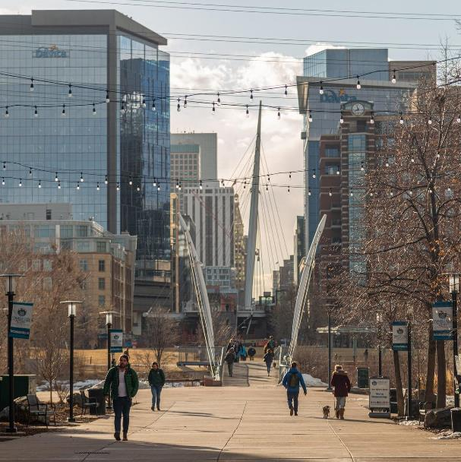
Important considerations
Shifting the environmental burden and unintended consequences?: In instances we solve a problem and create another, e.g. replacing single-use plastic bags with paper bags.
Sustainable outcomes: Will the benefits continue after the end-life of initiatives?.
Economic flows: Shifting of productive activities to outside of city economies need to be limited, coordinated or supplemented with new activities.
Social aspects: Are we taking into account three important dimensions? Access, Participation and Opportunity.

Slide 41
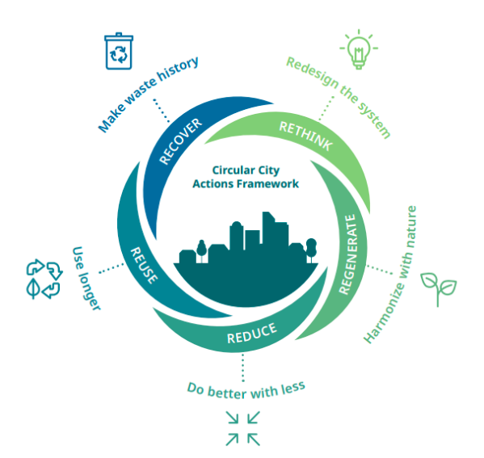
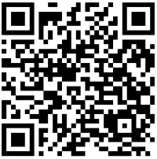
Circular Cities Action Framework and Reuse
Circular Cities Action Framework
Reuse:
Design and regulate for extended use.
Facilitate second-hand markets, sharing and exchange platforms.
Support resume, repair, remanufacturing and maintenance of existing resources, products, spaces and infrastructure.

Slide 42
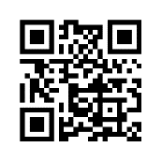
Thank you!
Get in touch:
circular.development@iclei.org
https://circulars.iclei.org/

Slide 43
Financial incentives to reduce single-use packaging - The single use packaging tax in the city of Tübingen Tobias Staufenberg, Environmental and Climate Protection Unit of the municipality of Tübingen
Stadt und Bürgerschaft

Slide 44
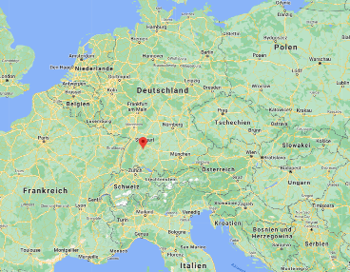
Tübingen 90.000 inhabitants 27.000 university students 30km south of Stuttgart

Slide 45
Why a local tax on packages?
Increasing amounts of disposable packagings in public spaces
Annual costs of 700.000 € for disposal
Create an incentive to use reusable packagings
No regulation / incentive on the national level
Ressource protection = Climate protection
Fotos: Hans-Peter Kern
Notes:
Kosten für Beseitigung von Müll aus dem öffentlichen Raum durch KST sind zwischen 2016 und 2017 um 50.000 € gestiegen.

Slide 46
How does it work?
0,50 € on every single use food package
0,50 € on every single use drink package
0,20 € on single use cutlery
No tax if:
Reusable packing is used (e.g. as part of a deposit system)
Food/drink are not consumed promptly

Slide 47
How does it work?
≈440 businesses affected
Revenue ist expected to amount to several hundred thousand Euros.
1,5 full-time positions in the tax department needed for tax collection

Slide 48
We support alternatives!
Local subsidies for businesses transitioning to reusable packages
500 € for packages (per shop)
1000 € for dishwashers (per shop)
108 businesses have been subsidizied since 2020
Currently 158 shops with reusable packages
Three fairs for reusable packages organized by administration
Connecting local business with companies offering reusable packaging

Slide 49
We support alternatives!
Tax is a catalyst for the usage of reusable packages
53.000 € in subsidies have been disbursed to local businesses so far
170 businesses offering reusable packagings

Slide 50
Process
12/2018: municipal council orders administration to prepare a tax bylaw.
2019: intensive research into legal and practical affairs
Q3+4 2019: meetings with local gastronomers regarding taxing and reusable packagings
01/2020: municipal council enacts the tax bylaw, being in effect as of 01/2021
05/2020: administration starts aid programm for local gastronomy to support transition towards reusable packages

Slide 51
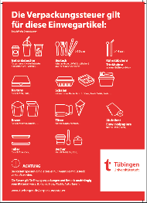
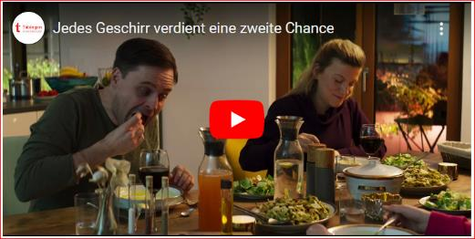
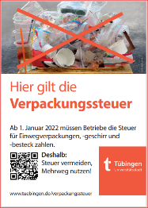
Process
07/2020: due to Covid19 pandemic municipal council shifts start of taxation to 01/2022
07/2021: Information about process of taxation sent to local shops.
Q3+4 2021: intense counseling of local shops
Q4 2021: Information campaign towards the public

Slide 52
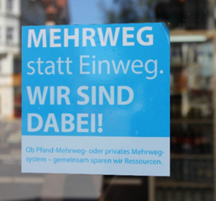
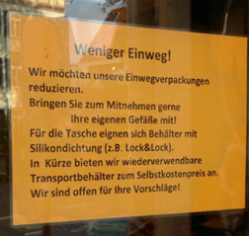
Does it work?
Tax has been in effect since January 2022
Visibly less trash in and around public trash bins
Much more people using reusable packages
Many local businesses completly phased out single-use packagings for food and drinks

Slide 53
Looking forward
Tax collecting for 2022 started in fall of 2023
Additional information and counseling of local businesses will be necessary regarding taxation and the use of renewable packages
More and more cities ask for information about the tax and think about implementing simmilar taxes

Slide 54
Thank you for your attention!
Tobias Staufenberg
tobias.staufenberg@tuebingen.de
+49-7071-204-2485

Slide 55
Time for Questions!
With Magash Naidoo (ICLEI)
and Tobias Staufenberg (City of Tübingen)

Slide 56
Circular City Labs – Next steps
Albania:
Open Call for Tender for accelerator implementation in Tirana
Colombia:
Kick-off event in Medellín: 15th of February
Online workshop series: 7th, 14th and 21st of March
Georgia:
Kick-off event in Tbilisi: end of February or beginning of March
Global activities:
Leadership Training for Female Multipliers in the Circular Economy: Starting next week
Next webinar: Probably October 2024
Notes:
Address participants of Leadership Training

Slide 57
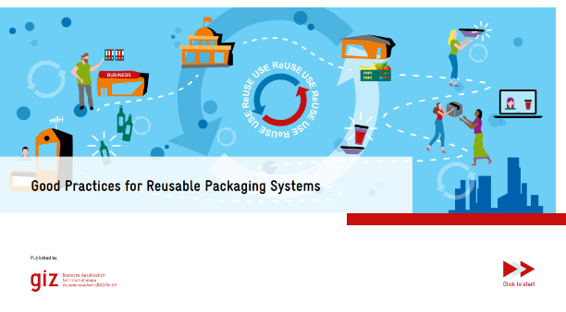
Get in touch!
Share your email address in the chat or contact:
CCL Global
Colombia
Georgia
Albania
Jana.schwalm@giz.de
Camilo.herrera@giz.de
Nino.janashia@giz.de
Valbona.koci@giz.de and
Angelina.schreiner@giz.de
Become part of our brochure
"Good Practices for Reusable Packaging Systems"

Slide 58
Additional links
Study recommendation
LCA in takeaway reuse (zerowasteeurope.eu)
Hygiene standards and cleaning of reusable packaging
Merkblatt „Pool-Geschirr“ - Hygiene beim Umgang mit Mehrweggeschirren innerhalb von Pfand-Poolsystemen (lebensmittelverband.de)
Reusable packaging system design - washing, sanitization and handling of foodware (resolve.ngo)
Pfand-Poolsysteme: Worauf du bei Pfandgeschirr aus Poolsystemen achten solltest (youtube.com) (English subtitles can be activated)
Reuse city example
The story of Tübingen (zerowastecities.eu)
Reuse communities
Platform & Network for Reusable Packaging (planetreuse.eu)
EU Reuse Alliance (newreusealliance.eu)
Community (reuseportal.org)

