Slide 1
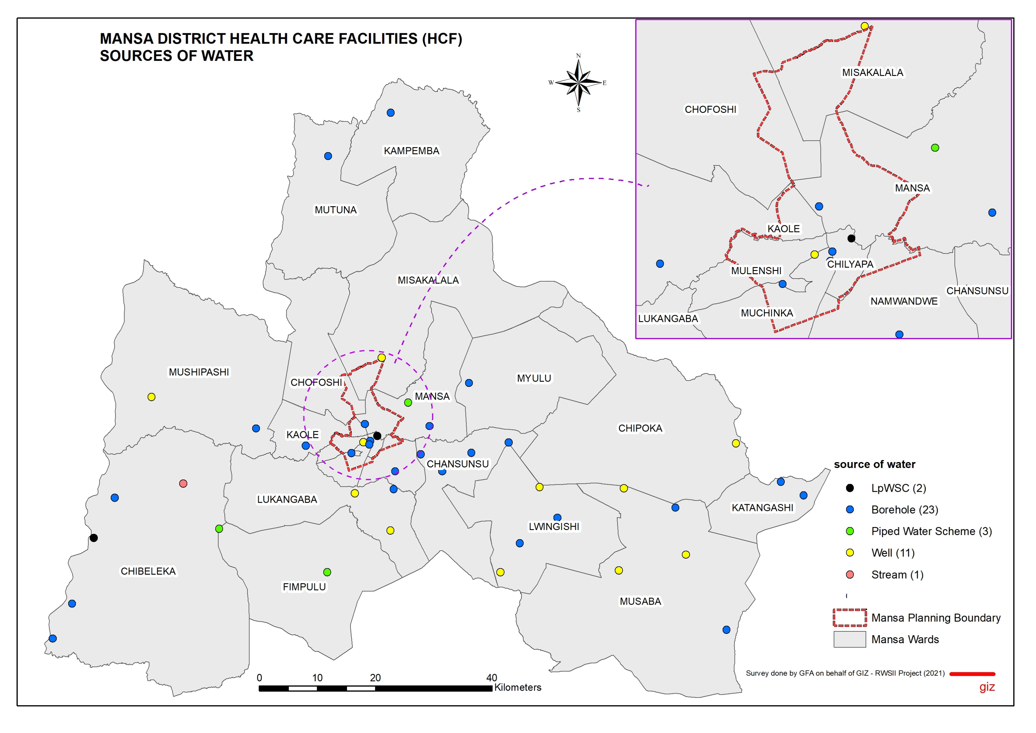
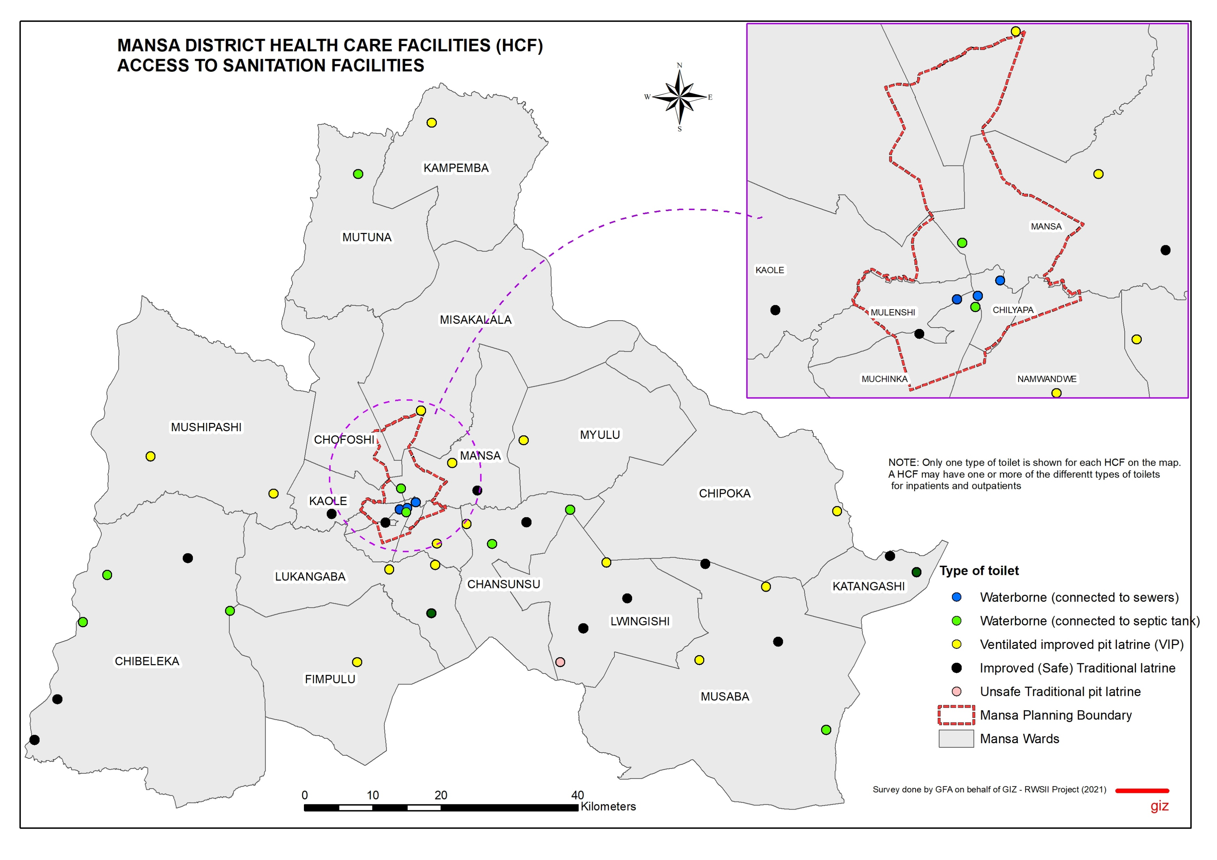
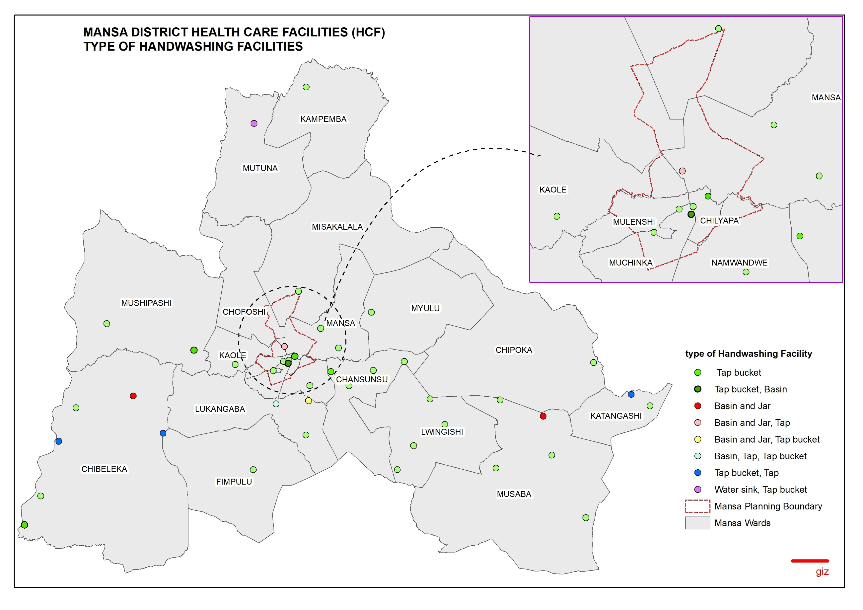
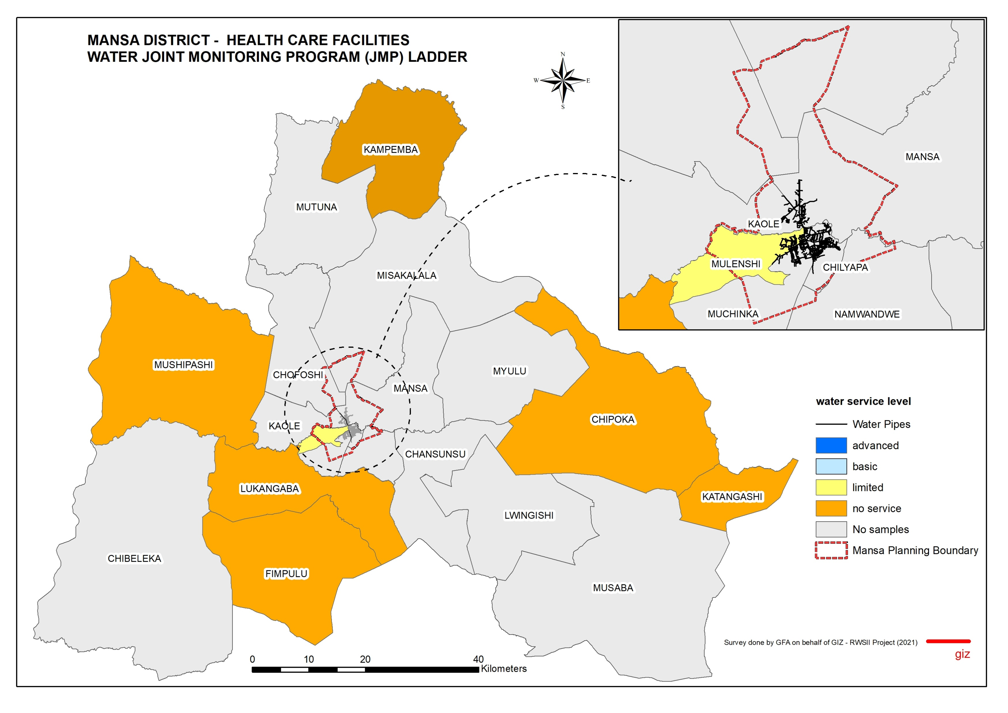
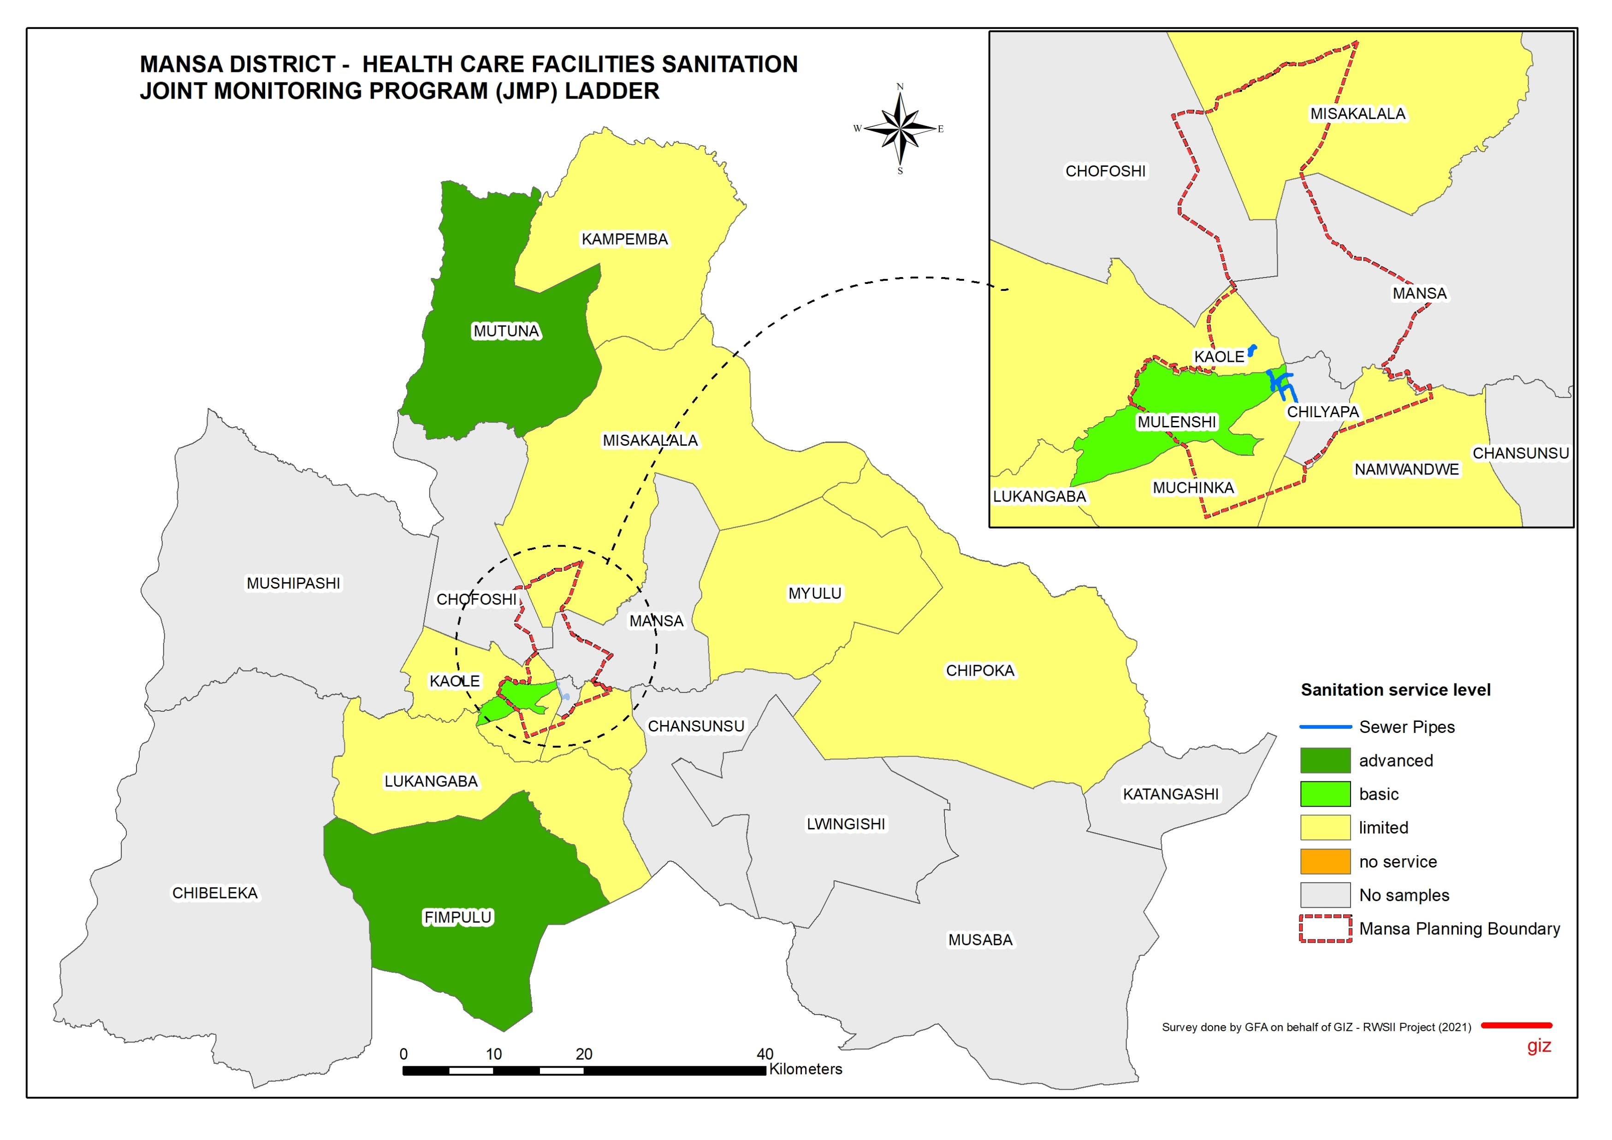
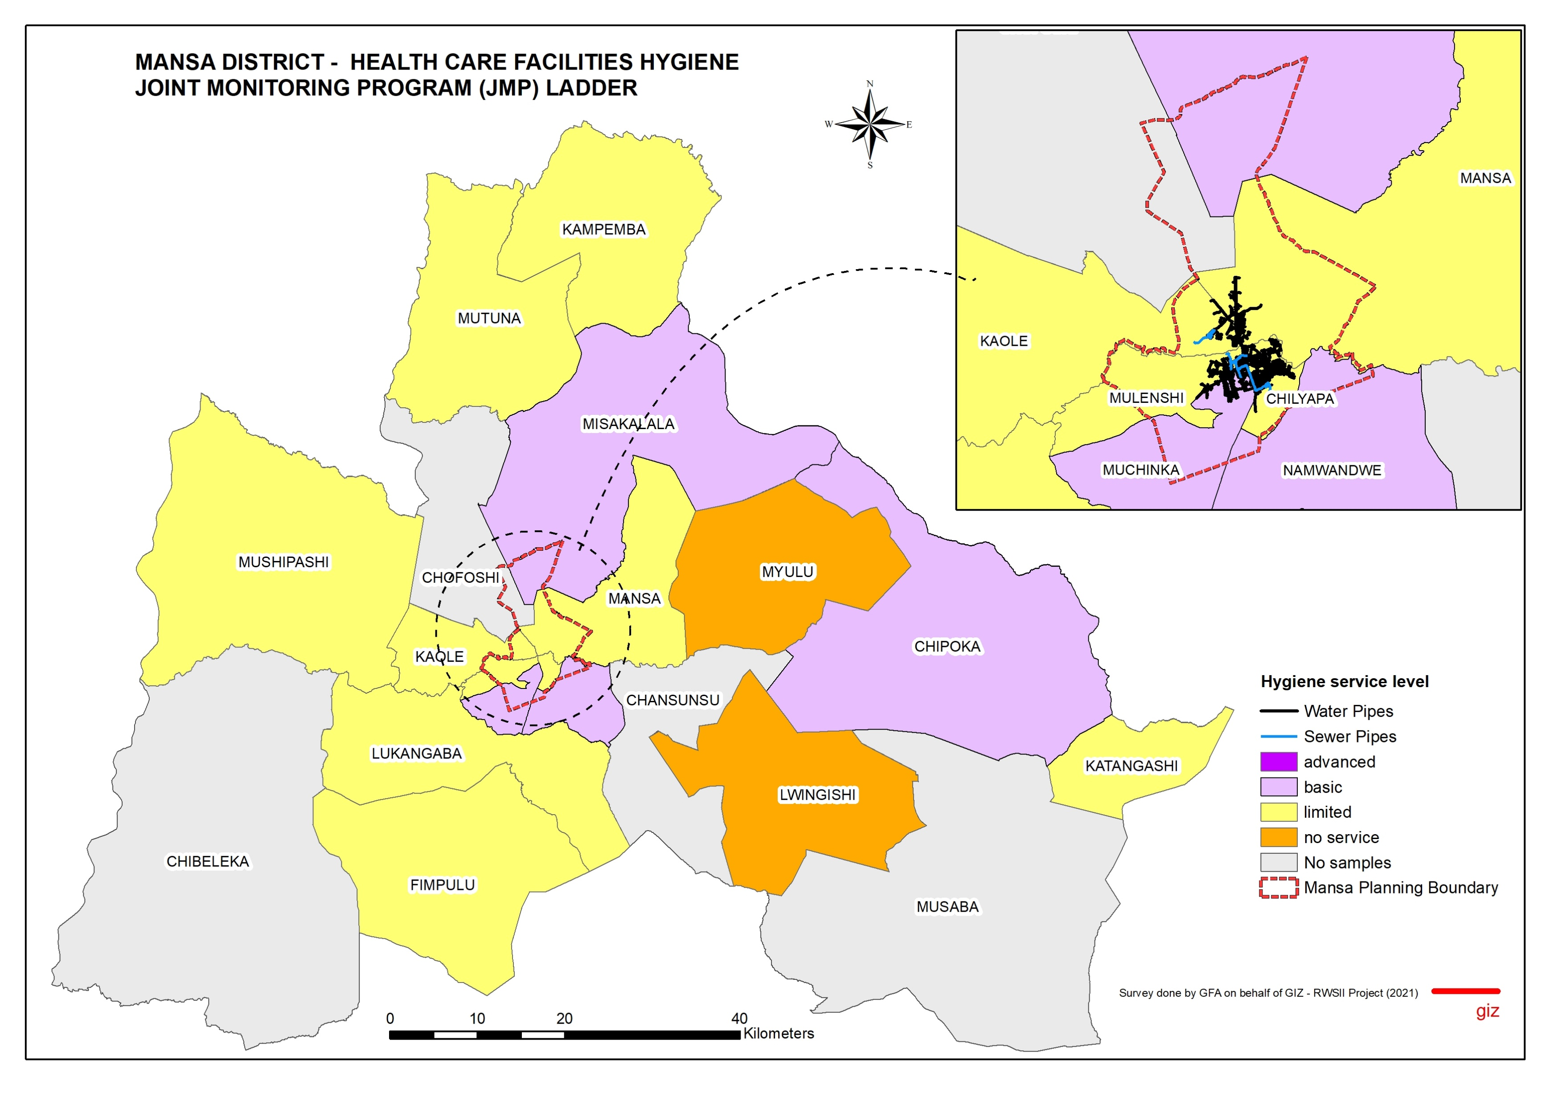




2021 WASH Baseline Mansa District – Health Care Facilities
ACCESS TO DRINKING WATER
ACCESS TO SANITATION
ACCESS TO HYGIENE
Water Source (%)
Water Continuously Available (%)
Willingness to Connect to LpWSC (%)
Sufficiency of Sanitation Facilities (%)
Sanitation Facilities Usability (%)
Types of Hand Washing Facility
Hand Washing Facilities
equipped with soap
In Mansa District, all the Health Care Facilities surveyed had hand washing facilities. 9% used tap buckets as a handwashing facility. 91% had toilets equipped with soap and hand sanitizers.
In Mansa District, the main type of sanitation for Health Care Facilities was Ventilated Improved Pit Latrines (VIPs). Very few were connected to the LpWSC sewer network and 74% of those not connected to LpWSC were willing to be connected to the sewer line. 48% of the Health Care Facilities had sufficient sanitation facilities and 86% had usable sanitation facilities.
In Mansa District, the main sources of water for Health Care Facilities were boreholes (57%) and wells (28%). Very few Health Care Facilities (5%) were connected to the LpWSC water network.
69% of the Health Care Facilities had continuous availability of water from their water sources.
81% of the Health Care Facilities that were not connected to LpWSC were willing to get connected.
DRINKING WATER SERVICE LEVELS (SDG 6.1/JMP LADDER)
SANITATION SERVICE LEVELS (SDG 6.2/JMP LADDER)
HYGIENE SERVICE LEVELS (SDG 6.2/JMP LADDER)
Service level | Definition
Advanced | Safely managed inclusive drinking water: Improved water facilities are located on premises, available when needed, accessible to persons with limited mobility and good water quality.
Basic | Water is available from an improved source on the premises.
Limited | An improved water source is within 500 metres of the premises, but not all requirements for basic service are met.
No Service | Water is taken from unprotected dug wells or springs, or surface water sources; or an improved source that is more than 500 metres from the facility; or the facility has no water source.
Service level | Definition
Advanced | The HCF has improved sanitation facilities at the facility premises, which are sufficient, MHM friendly, single sex for both staff and patients, usable and safely managed. Accessible to people with limited mobility.
Basic | Improved sanitation facilities are usable with at least one toilet dedicated for staff, at least one sex-separated toilet with menstrual hygiene facilities, and at least one toilet accessible for people with limited mobility.
Limited | At least one improved sanitation facility, but not all requirements for basic service are met.
No Service | Toilet facilities are unimproved (pit latrines without a slab or platform, hanging latrines and bucket latrines), or there are no toilets or latrines at the facility.
Service level | Definition
Advanced | Functional hand hygiene facilities (with water and soap and/or alcohol-based hand rub) are available at points of care, and within 5 metres of toilets. Availability of a shower.
Basic | Functional hand hygiene facilities (with water and soap and/or alcohol-based hand rub) are available at points of care, and within 5 metres of toilets.
Limited | Functional hand hygiene facilities are available at either points of care or toilets, but not both.
No Service | No functional hand hygiene facilities are available at either points of care or toilets.
Mansa | Drinking water
 | Total | Urban | Rural
Advanced | 33% | 75% | 24%
Basic Service | 19% | 13% | 21%
Limited Service | 31% | 0% | 38%
No Service | 17% | 13% | 18%
Total | 100% | 100% | 100%
Mansa | Sanitation
 | Total | Urban | Rural
Advanced | 24% | 25% | 24%
Basic Service | 12% | 0% | 15%
Limited Service | 60% | 75% | 56%
No Service | 5% | 0% | 6%
Total | 100% | 100% | 100%
Mansa | Hygiene
 | Total | Urban | Rural
Advanced | 19% | 13% | 21%
Basic Service | 29% | 38% | 26%
Limited Service | 52% | 50% | 53%
No Service | 0% | 0% | 0%
Total | 100% | 100% | 100%
Published by;
Reform of the Water Sector Programme Phase II (RWS II) in Zambia
Compiled by;
Gabriel Chibuye (GIS Expert)

