Slide 1
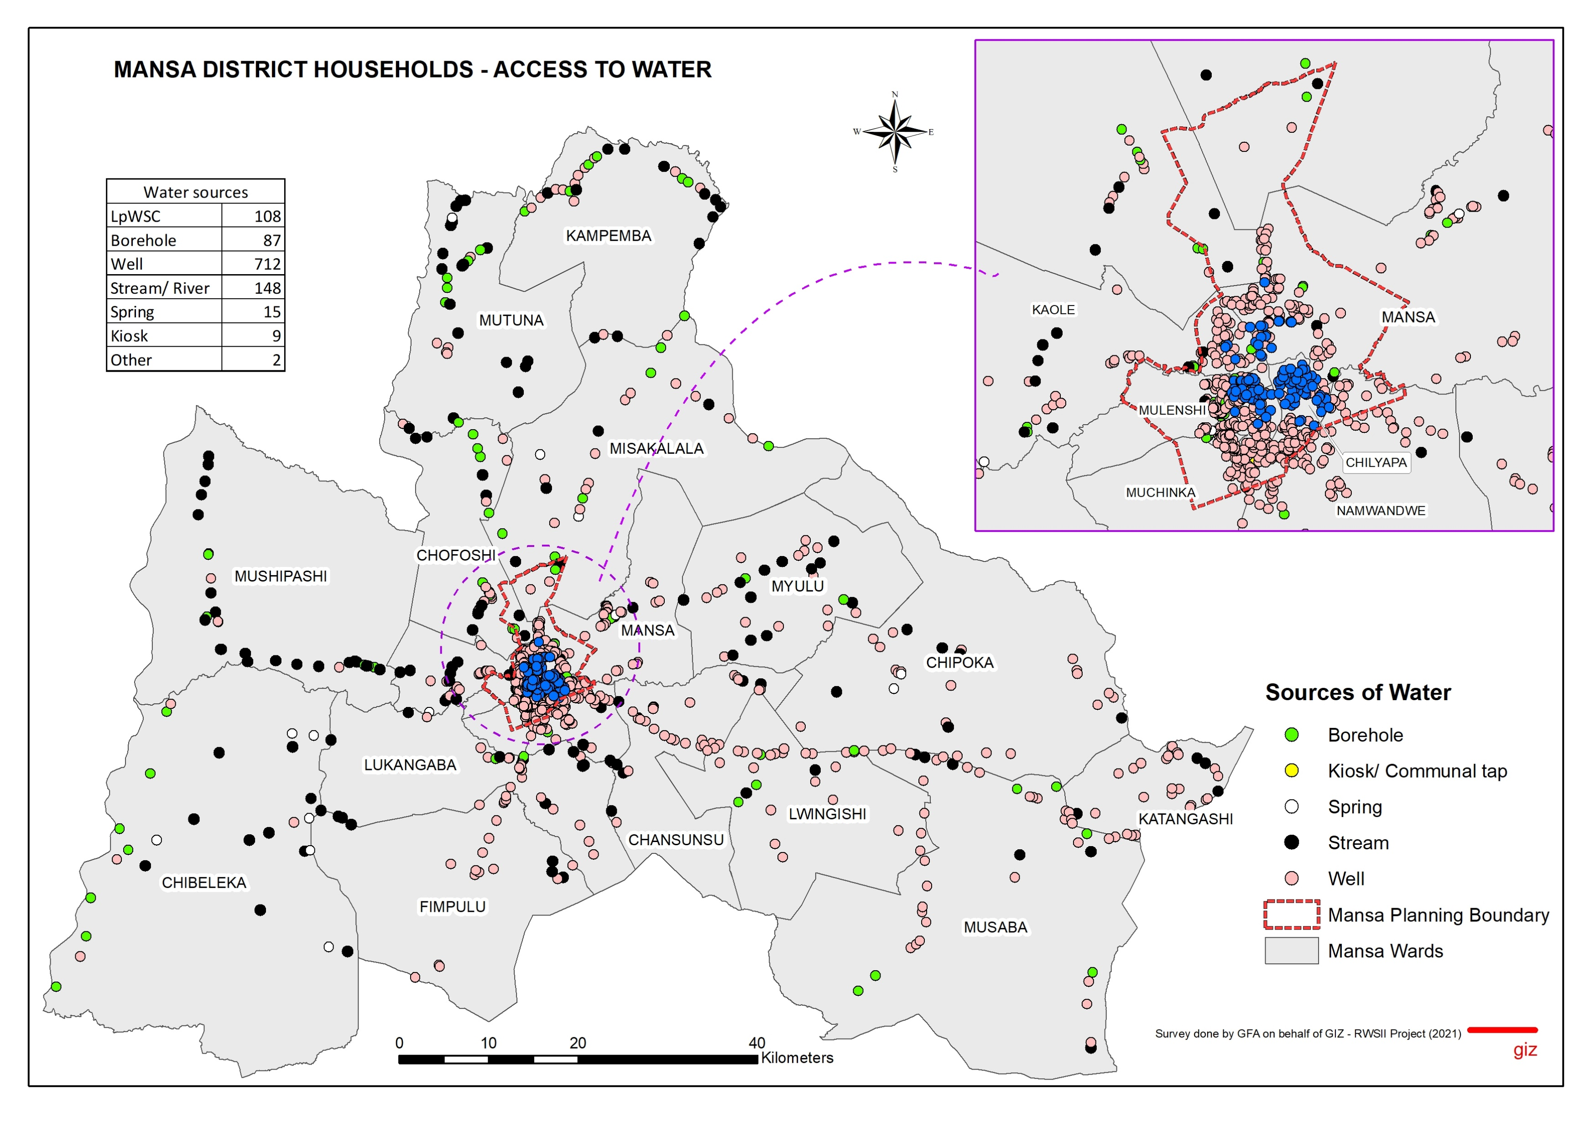
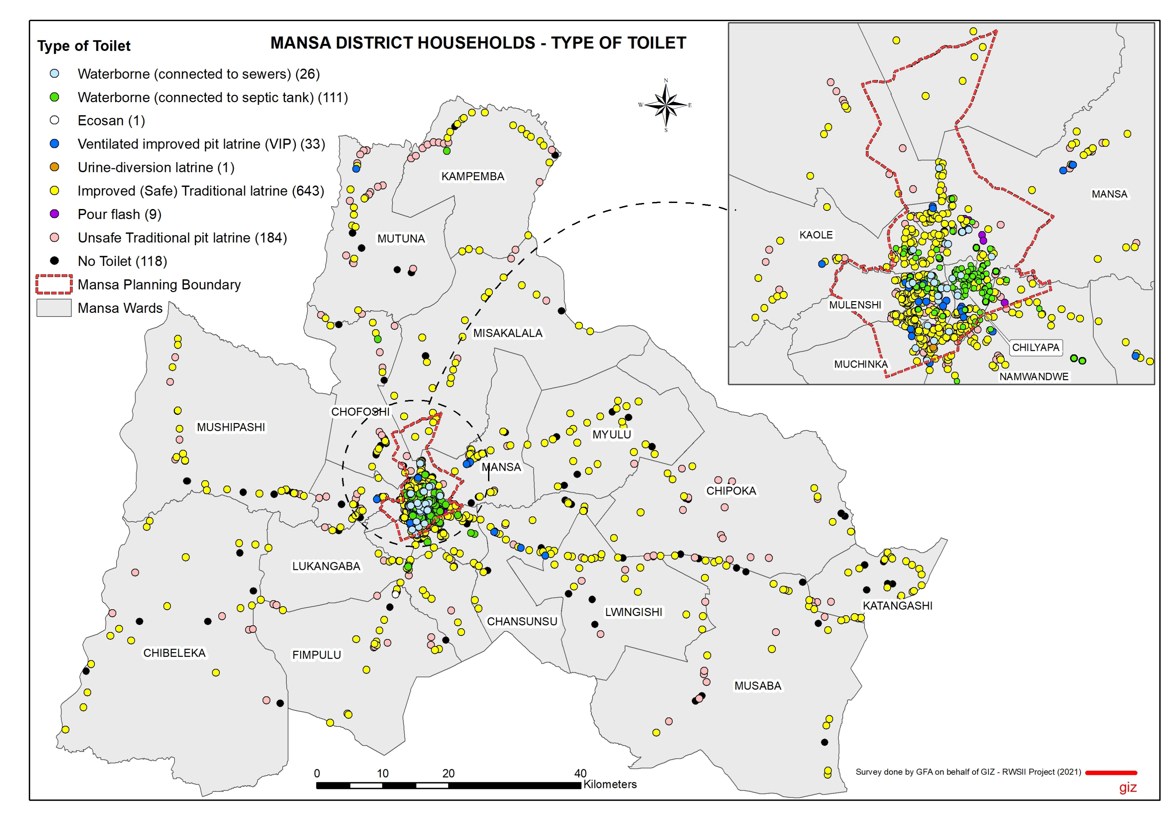
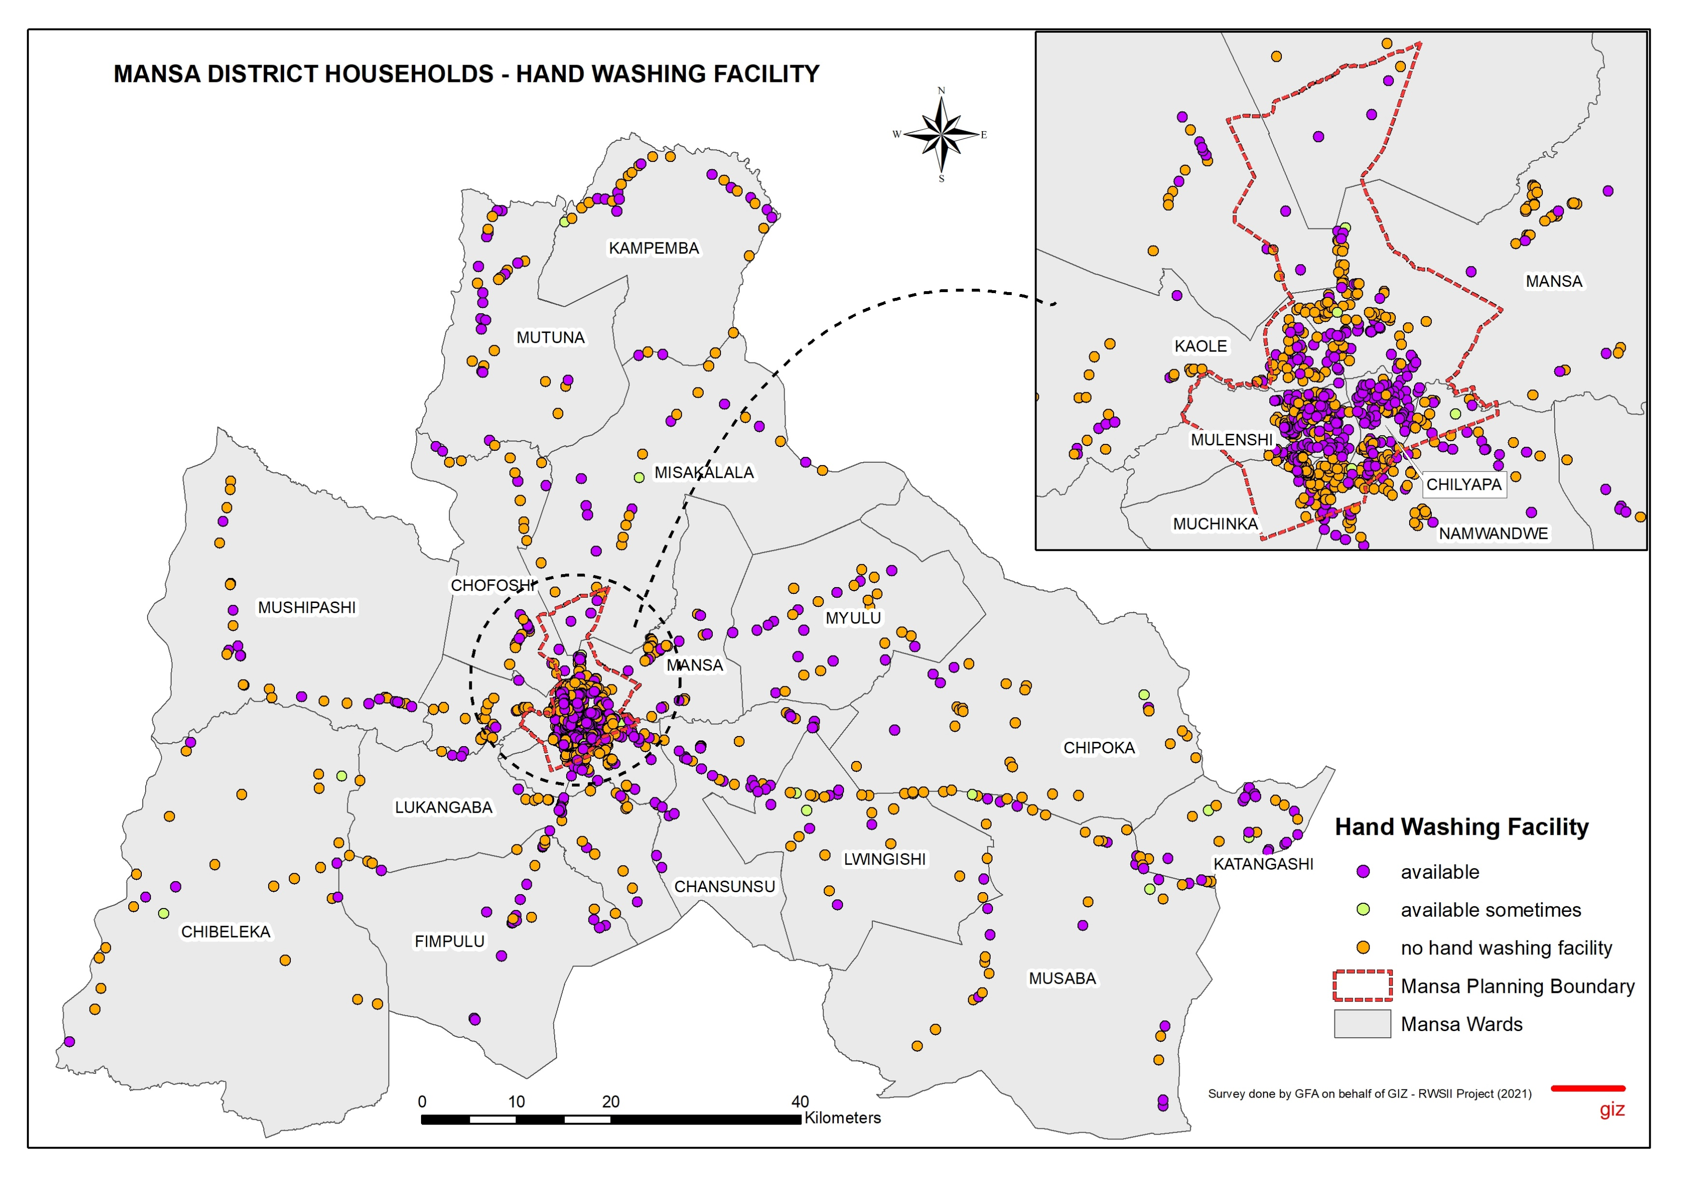
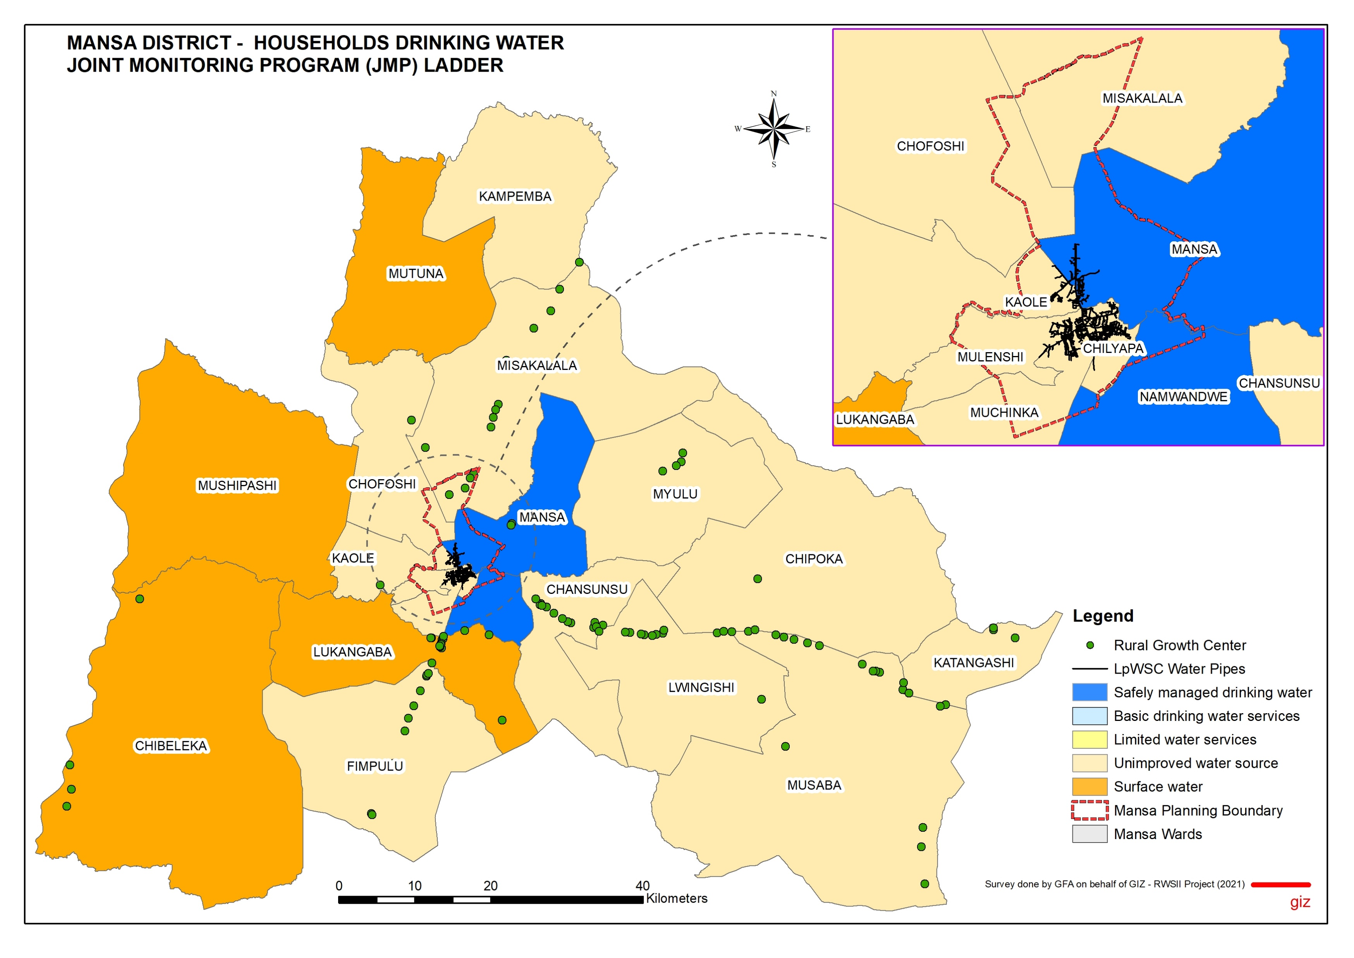
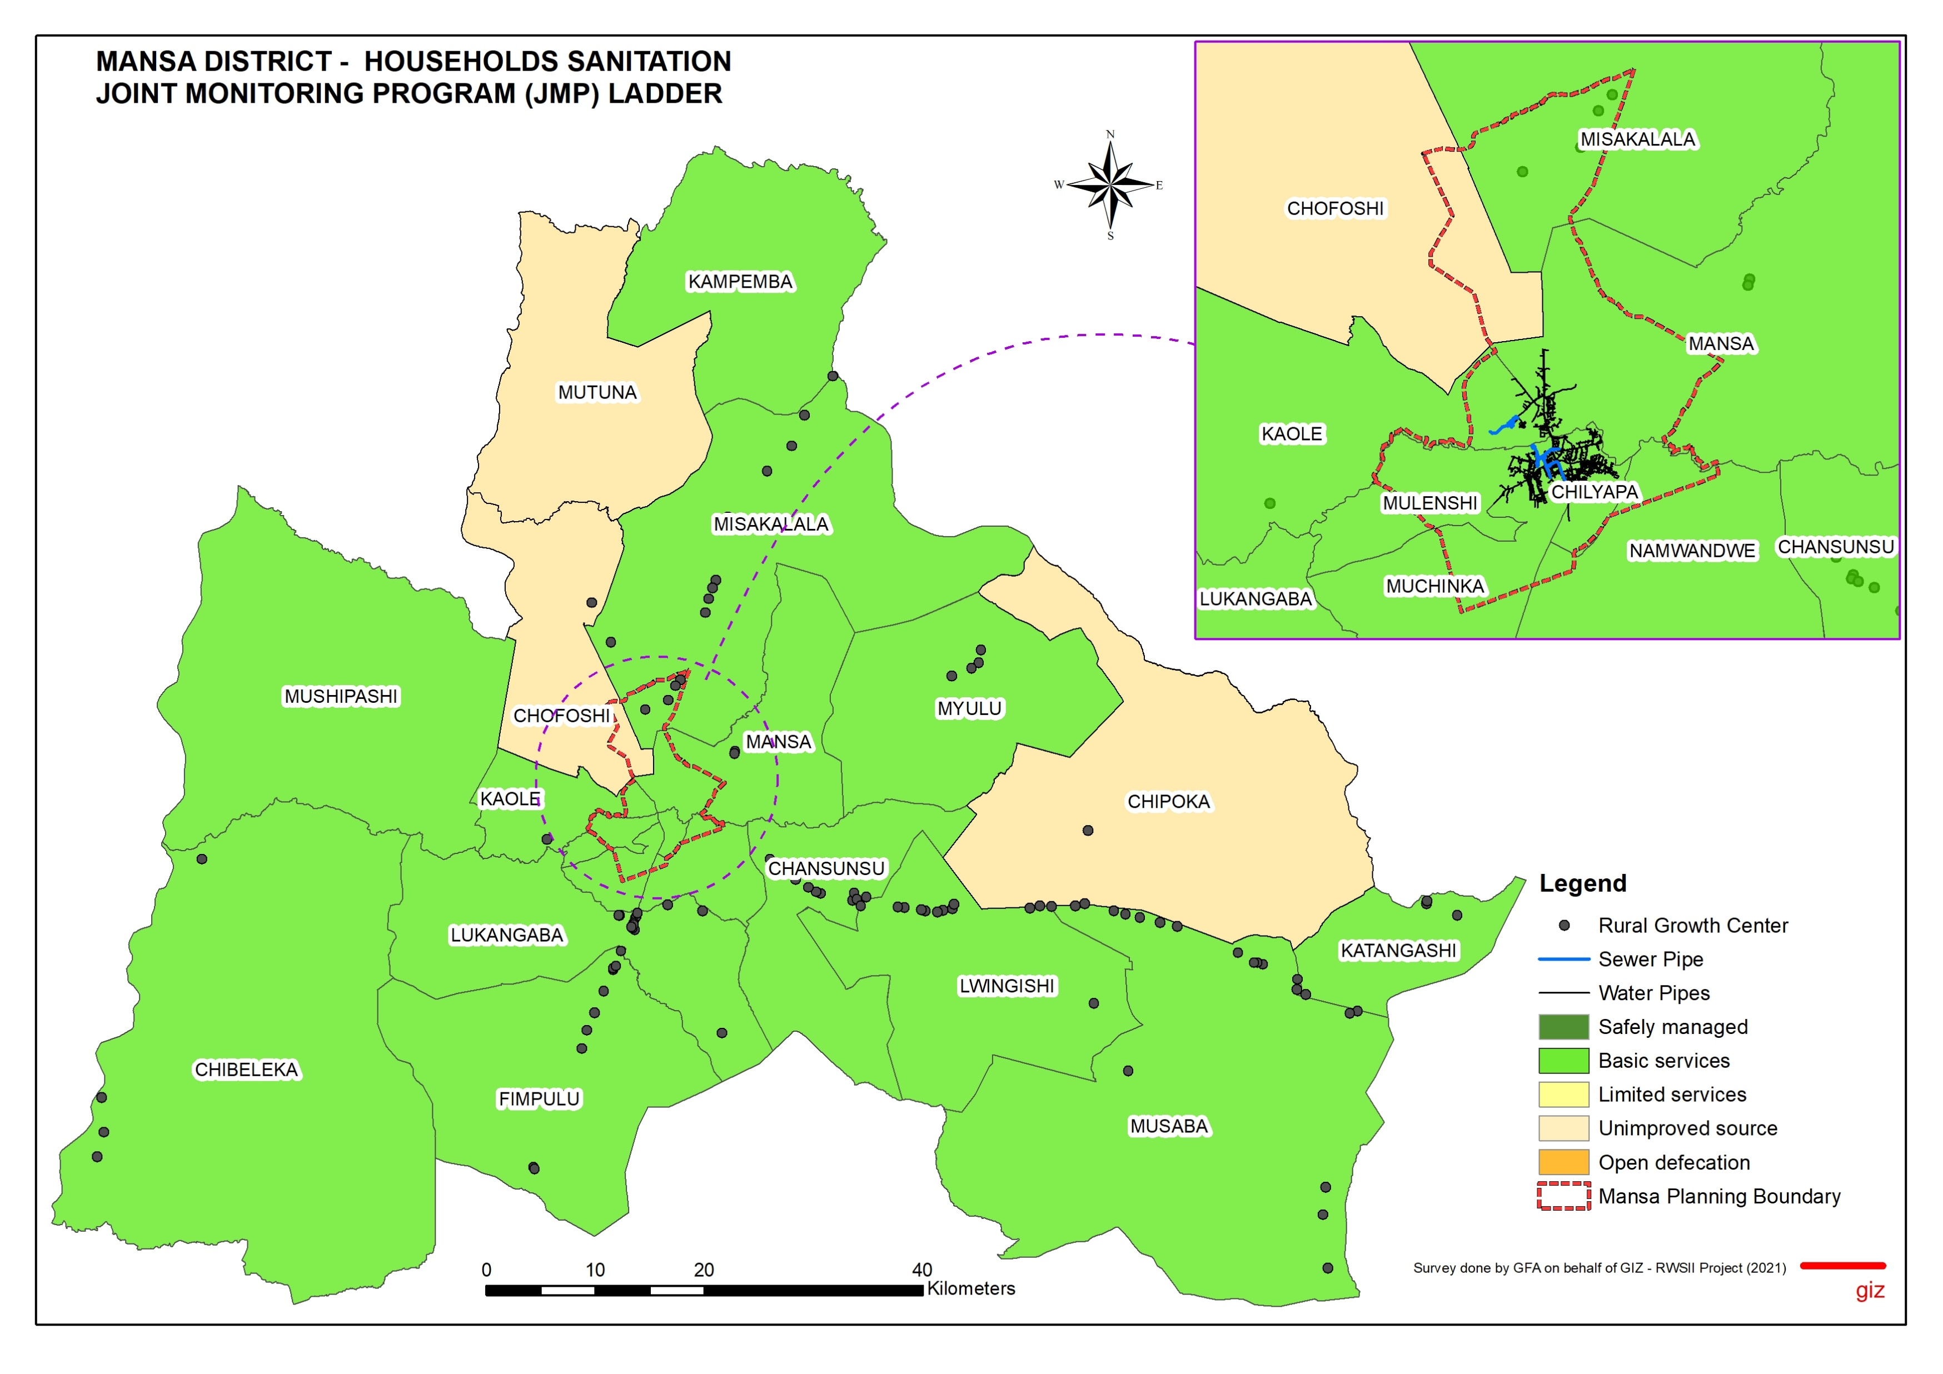
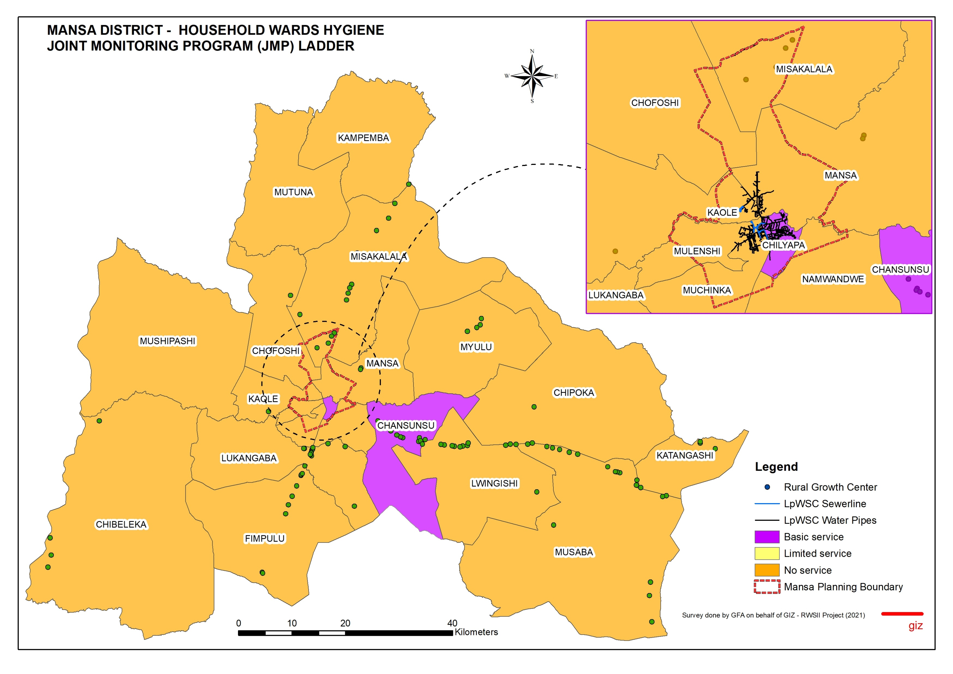




2021 WASH Baseline Mansa District - Households
ACCESS TO DRINKING WATER
ACCESS TO SANITATION
ACCESS TO HYGIENE
Type of Water Source (%)
Treatment of Drinking Water (%)
Methods of Water Treatment (%)
Willingness to connect to a sewer system
Amount willing to pay for construction and connection to sewer
Type of Toilet
Types of hand washing Facility
Availability of hand washing Facility
In Mansa District, 65% of the households surveyed were using wells as their main source of water. Only 10% of the households are connected to LpWSC. Most of the households not connected to LpWSC are willing to get connected. 52% of households treat their drinking water and 62% of these households use chlorination as the treatment method.
In Mansa district about 56.4% of households had improved facilities Improved traditional latrine. Only 2.4% had waterborne toilets connected to LpWSC system. 59% of households not connected to LpWSC were willing to connect and the majority were willing to pay less than K500 to connect to LpWSC system.
In Mansa District, the non-availability of handwashing facilities was found in both rural and urban areas. 53% of households do not have handwashing facilities. 26% of the households that had handwashing facilities used a basin and other alternatives (20%), which mainly included an open bucket. Most of the other types of handwashing facilities included buckets and other small containers.
DRINKING WATER SERVICE LEVELS (SDG 6.1/JMP LADDER)
SANITATION SERVICE LEVELS (SDG 6.2/JMP LADDER)
HYGIENE SERVICE LEVELS (SDG 6.2/JMP LADDER)
Mansa | Drinking water
 | Total | Rural | Urban
Safely managed | 22.37% | 6.44% | 35.11%
Basic service | 12.01% | 10.19% | 13.48%
Limited service | 13.59% | 9.98% | 16.47%
Unimproved | 33.73% | 41.16% | 27.79%
Surface water | 14.51% | 28.27% | 3.49%
No Data | 3.79% | 3.95% | 3.66%
Total | 100.00% | 100.00% | 100.00%
Service level | Definition
Safely managed | Drinking water from an improved water source which is located on the premises, available when needed, free from faecal & priority chemical contamination.
Basic | Drinking water from an improved water source & the collection time for a roundtrip including queuing is not more than 30 minutes.
Limited | Drinking water from an improved water source & the collection time for a roundtrip including queuing exceeds 30 minutes.
Unimproved | Drinking water from an unprotected dug well or unprotected spring
Surface water | Drinking water directly from a river, dam, lake, pond, stream, canal or irrigation canal
Mansa | Sanitation
 | Total | Rural | Urban
Safely managed | 2.22% | 0.21% | 3.83%
Basic service | 50.00% | 46.99% | 52.41%
Limited service | 12.85% | 7.48% | 17.14%
Unimproved | 17.19% | 23.28% | 12.31%
Open defecation | 11.92% | 16.84% | 7.99%
No Data | 5.82% | 5.20% | 6.32%
Total | 100.00% | 100.00% | 100.00%
Service level | Definition
Safely managed | Use of improved facilities that are not shared with other households and where excreta are safely disposed of in situ or transported and treated offsite.
Basic | Use of improved facilities that are not shared with other households
Limited | Use of improved facilities that are shared between two or more households.
Unimproved | Use of pit latrines without a slab, hanging latrines or bucket latrines.
Open defecation | Disposal of human faeces in fields, forests, bushes, open bodies of water and other open spaces.
Mansa | Hygiene
 | Total | Rural | Urban
Safely managed | - | - | -
Basic service | 27.36% | 22.66% | 31.11%
Limited service | 17.28% | 18.71% | 16.14%
Unimproved | - | - | -
No Service | 54.62% | 58.00% | 51.91%
No Data | 0.74% | 0.62% | 0.83%
Total | 100.00% | 100.00% | 100.00%
Service level | Definition
Basic | Availability of a handwashing facility on premises with soap and water.
Limited | Availability of a handwashing facility on premises without soap and water.
No facility | No hand washing facility on the premises.
Drinking water services refer to the accessibility, availability and quality of the main source used by households for drinking, cooking, personal hygiene and other domestic uses.
Sanitation services refer to the management of excreta from the facilities used by individuals, through emptying and transport of excreta for treatment and eventual discharge or reuse.
Hygiene refers to the conditions and practices that help maintain health and prevent the spread of disease including handwashing, food hygiene, and menstrual hygiene management.
Published by;
Reform of the Water Sector Programme Phase II (RWS II) in Zambia
Compiled by;
Gabriel Chibuye (GIS Expert)

