Slide 1
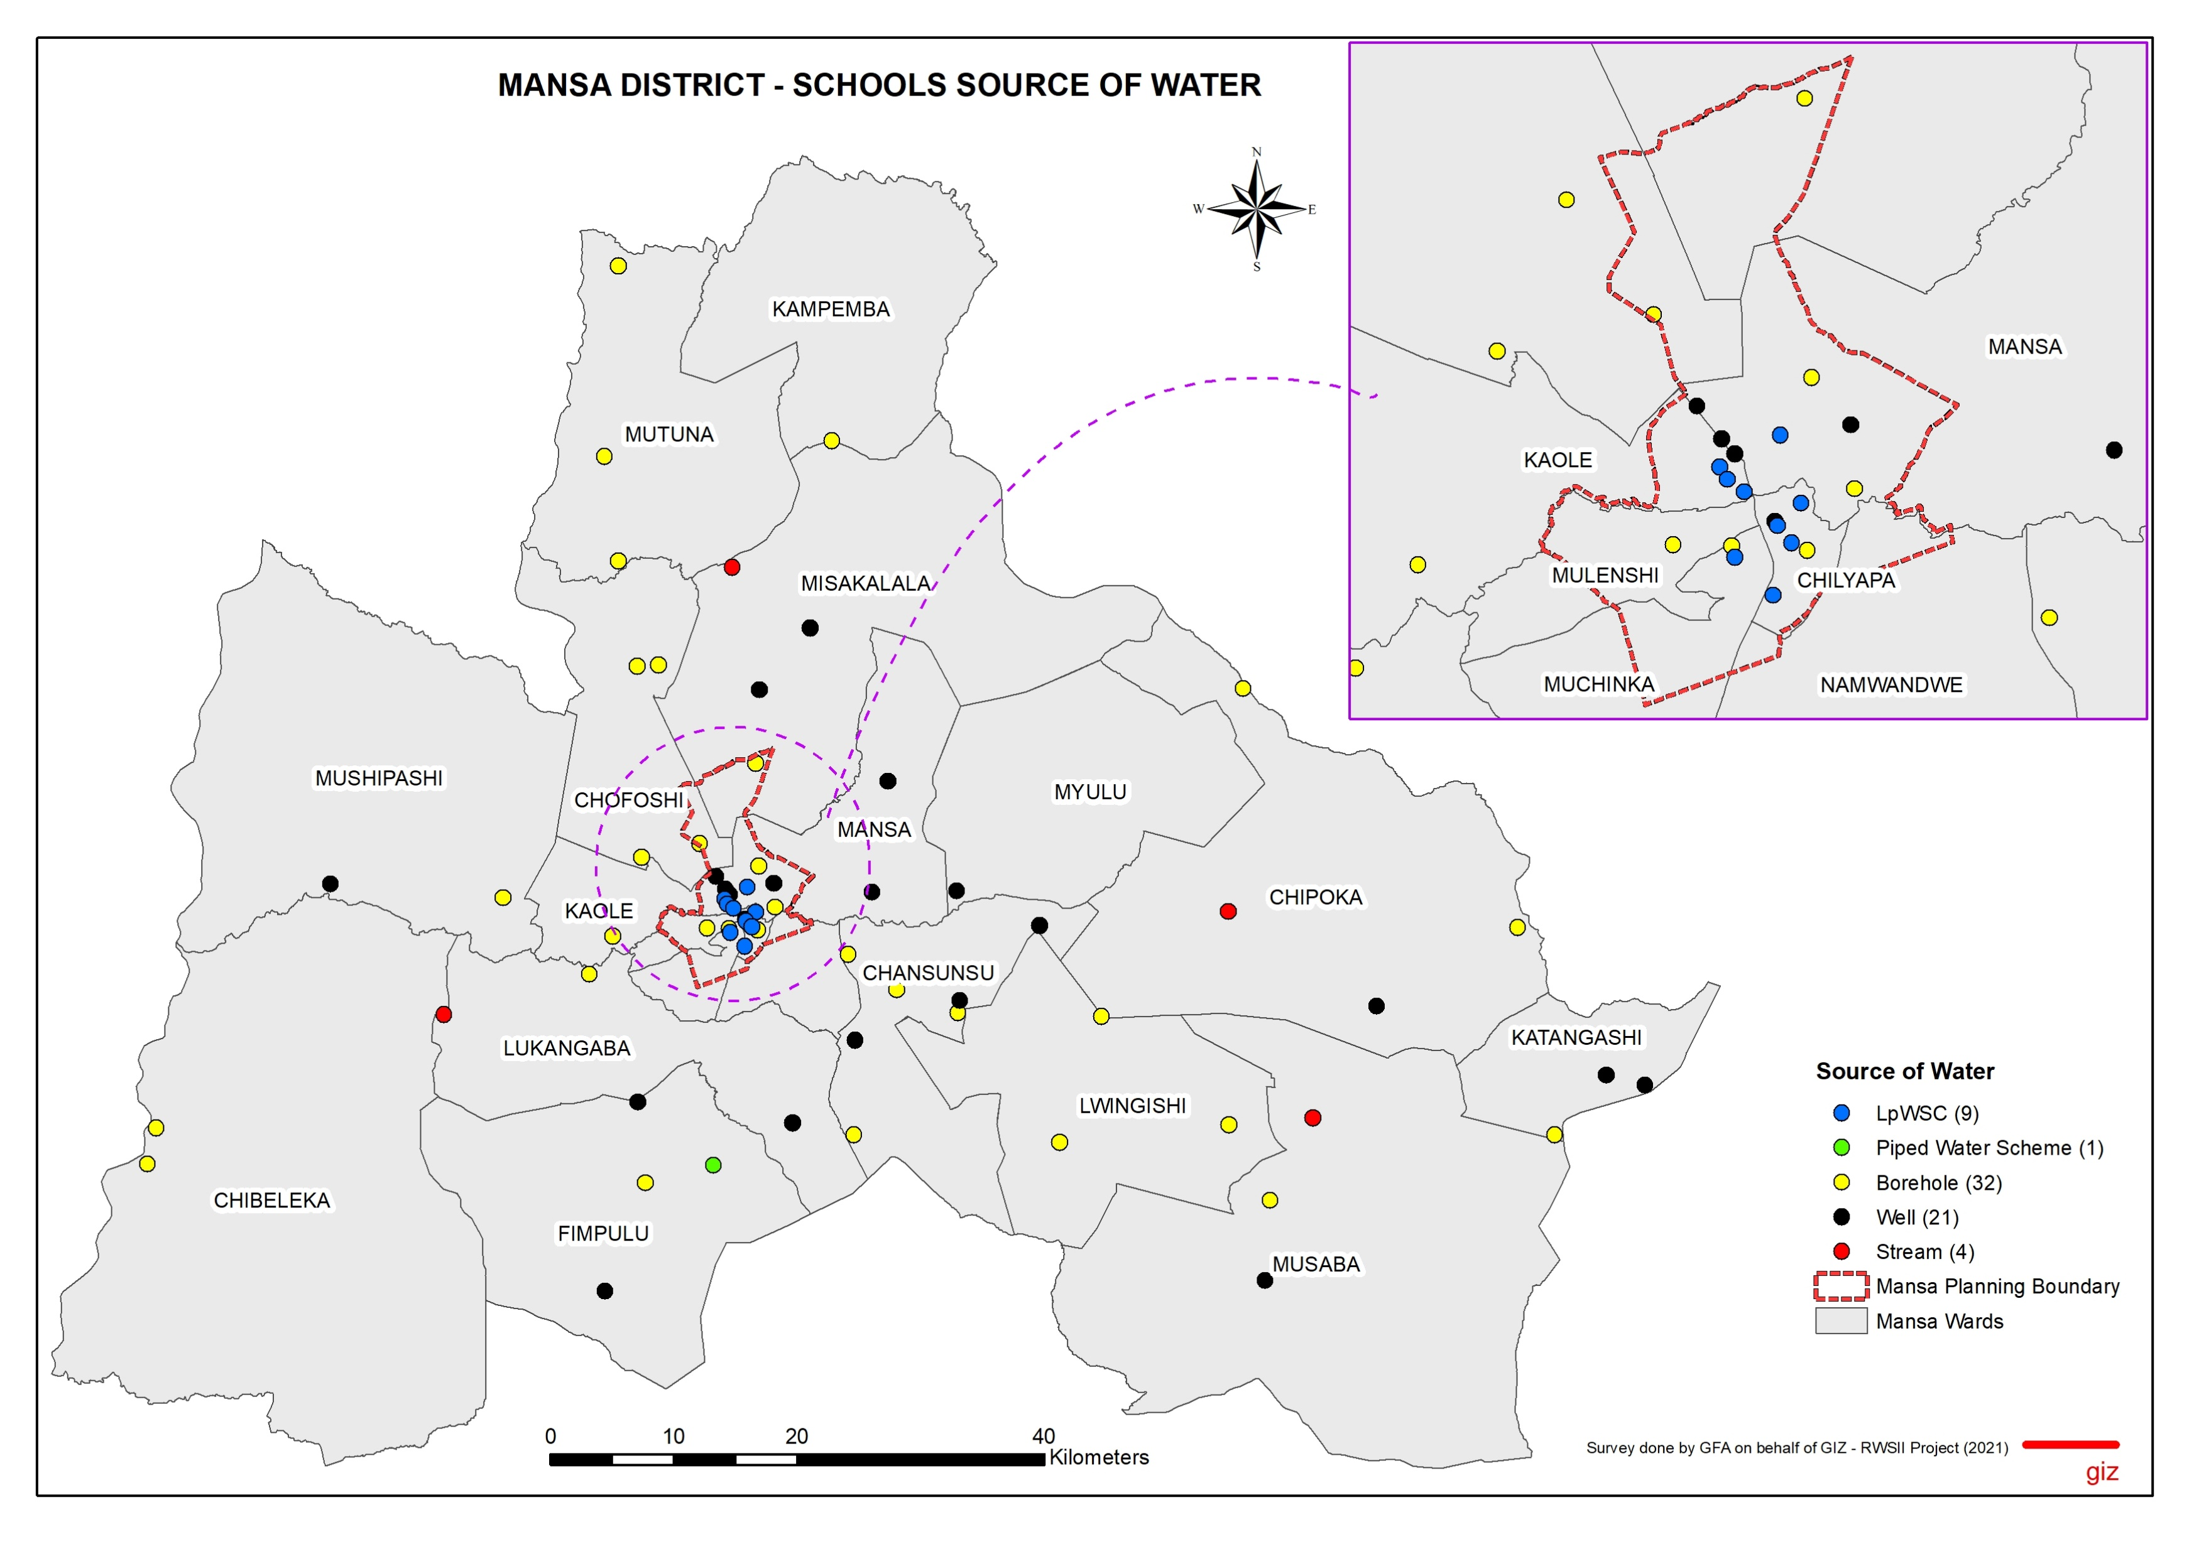
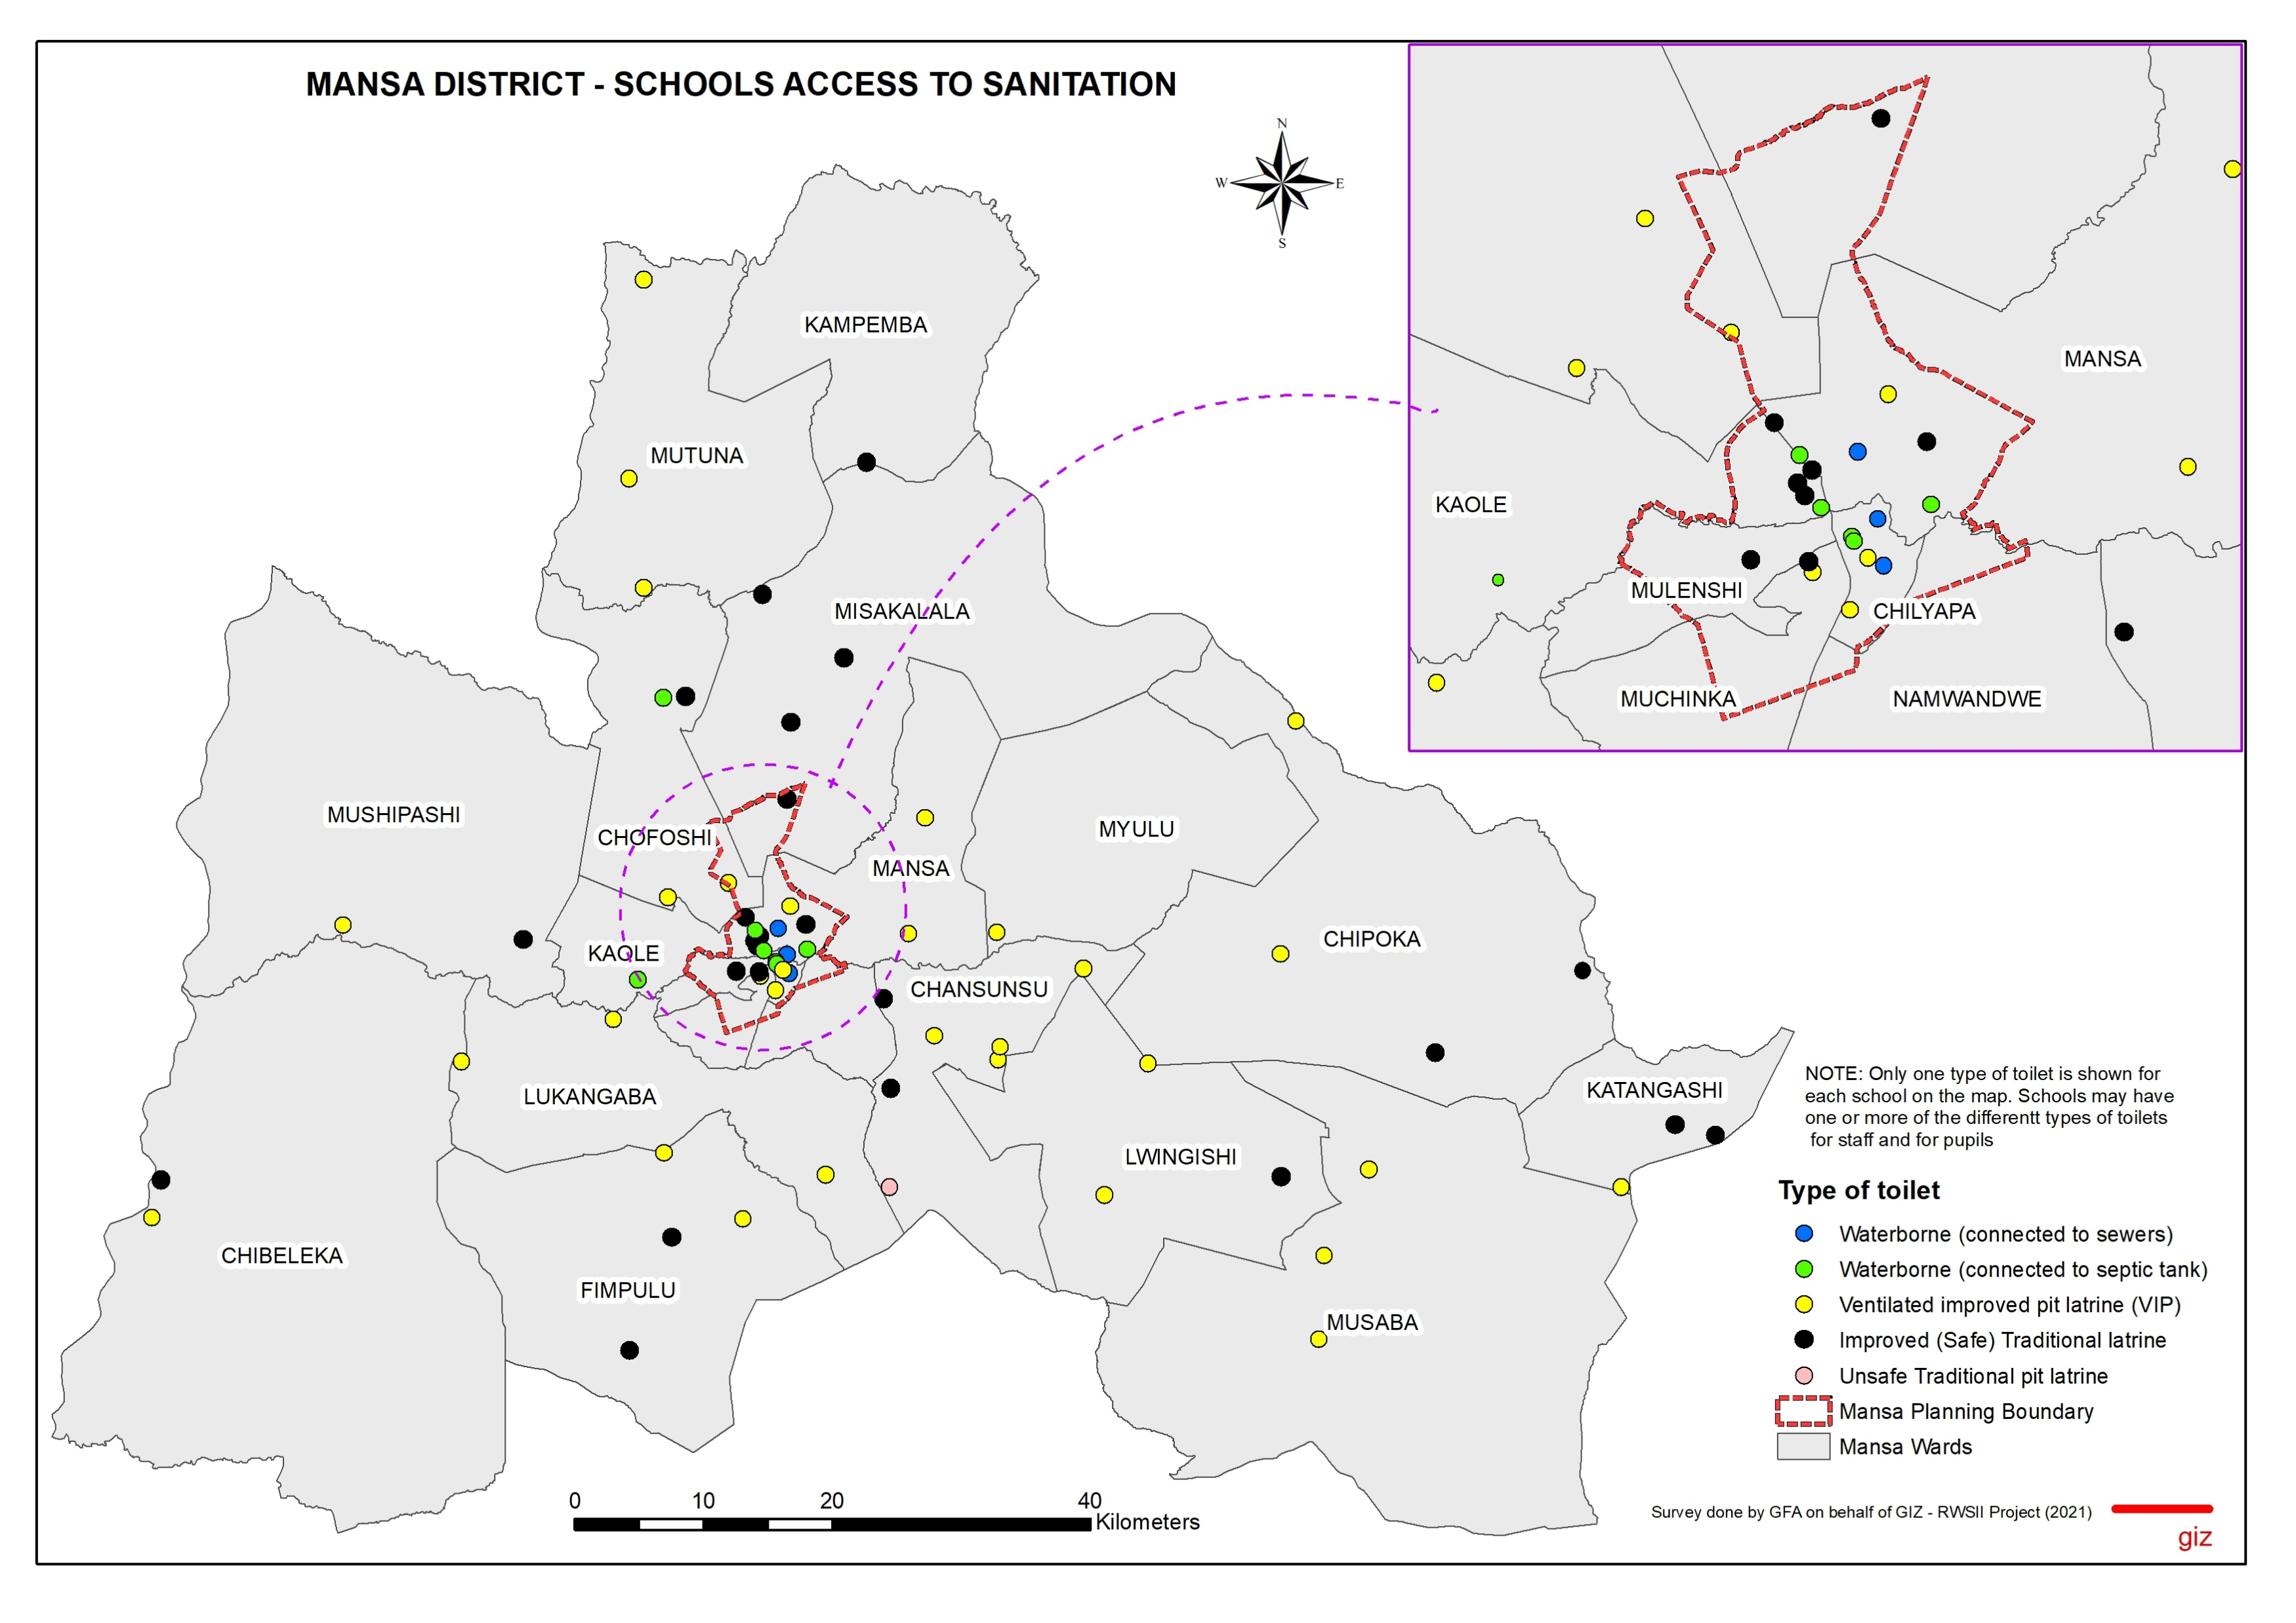
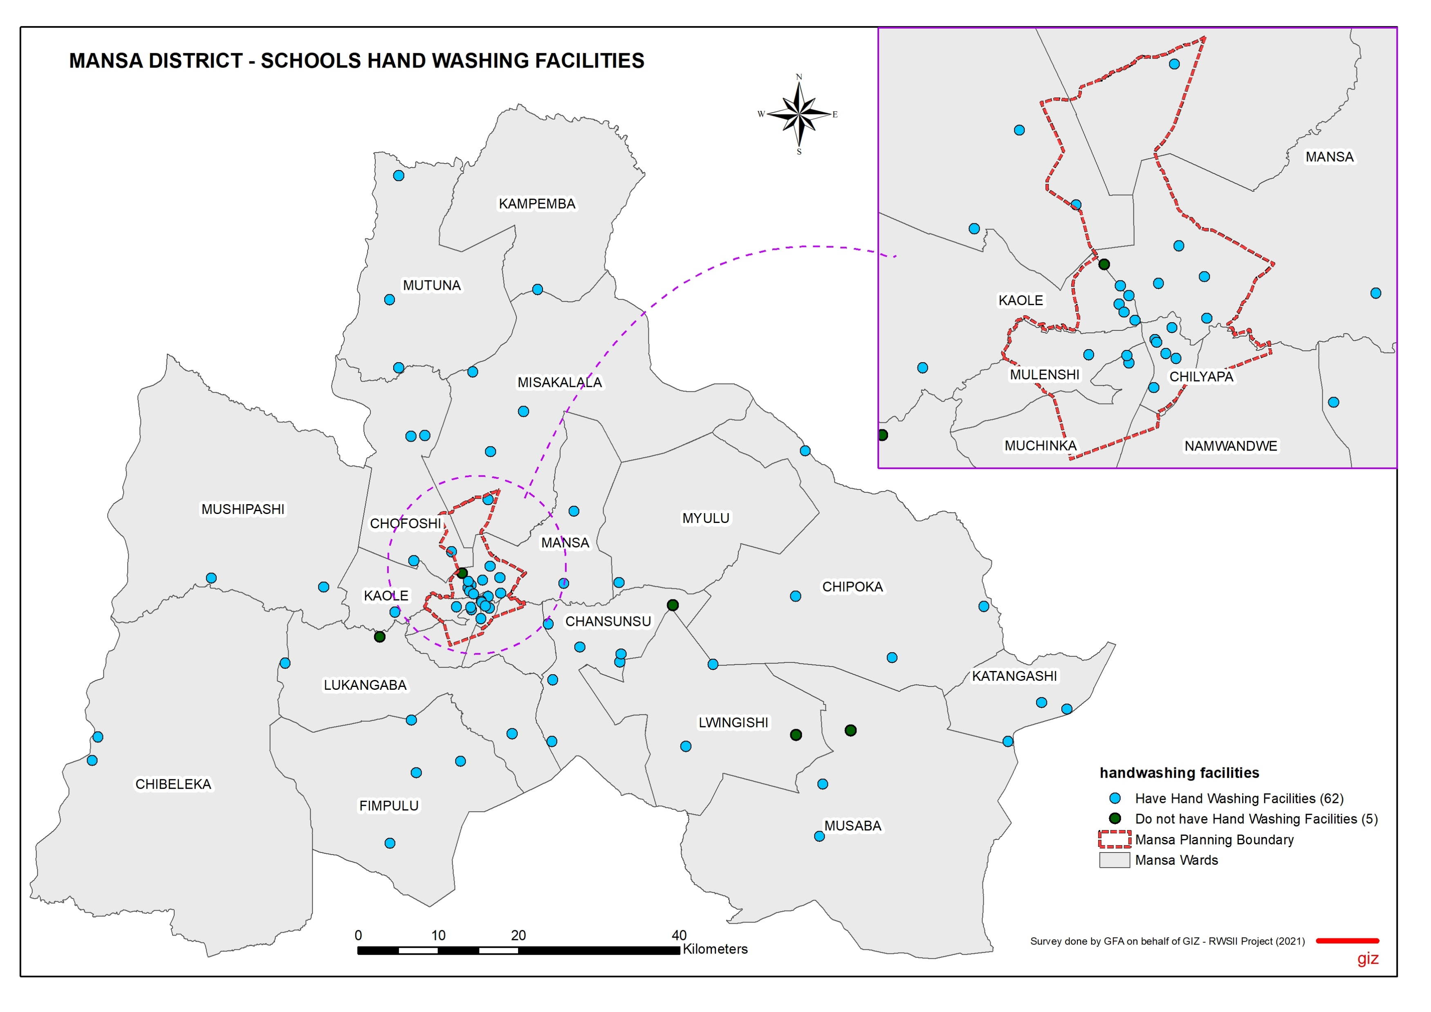
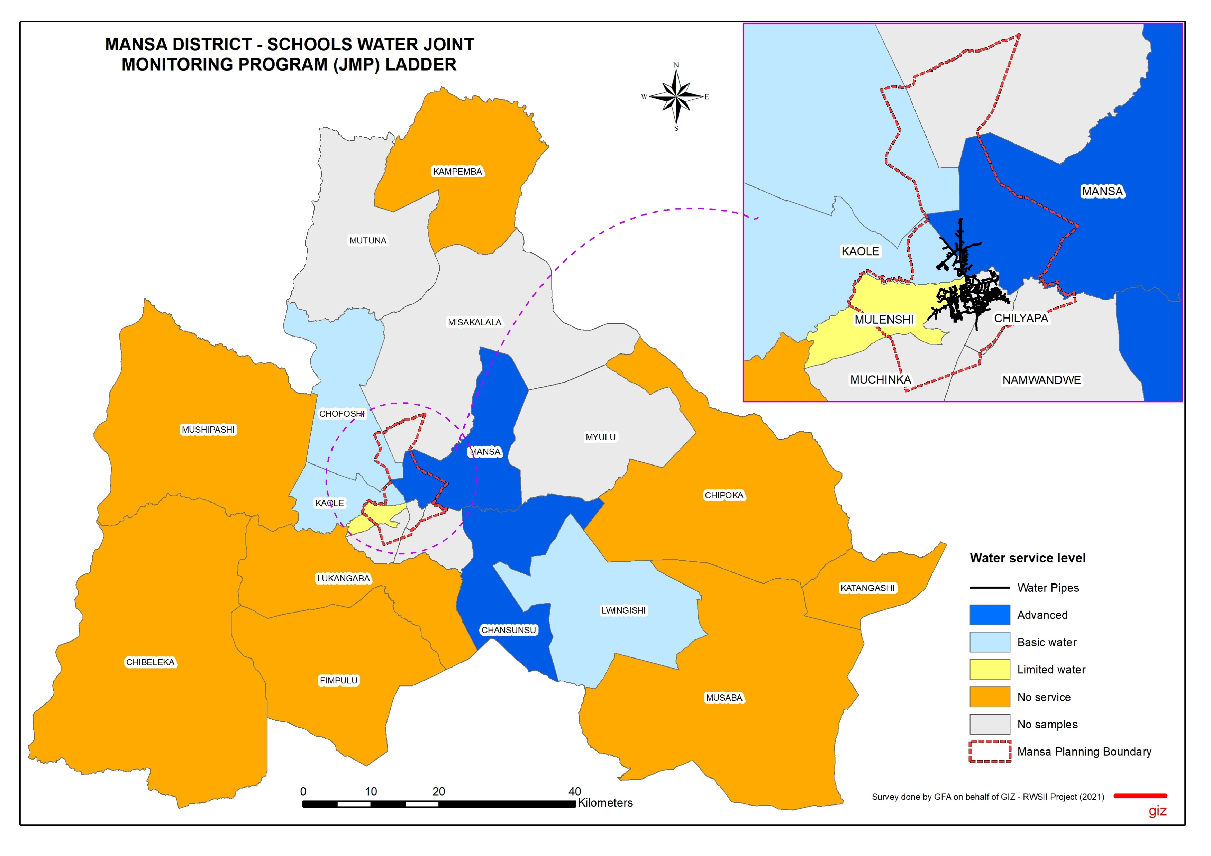
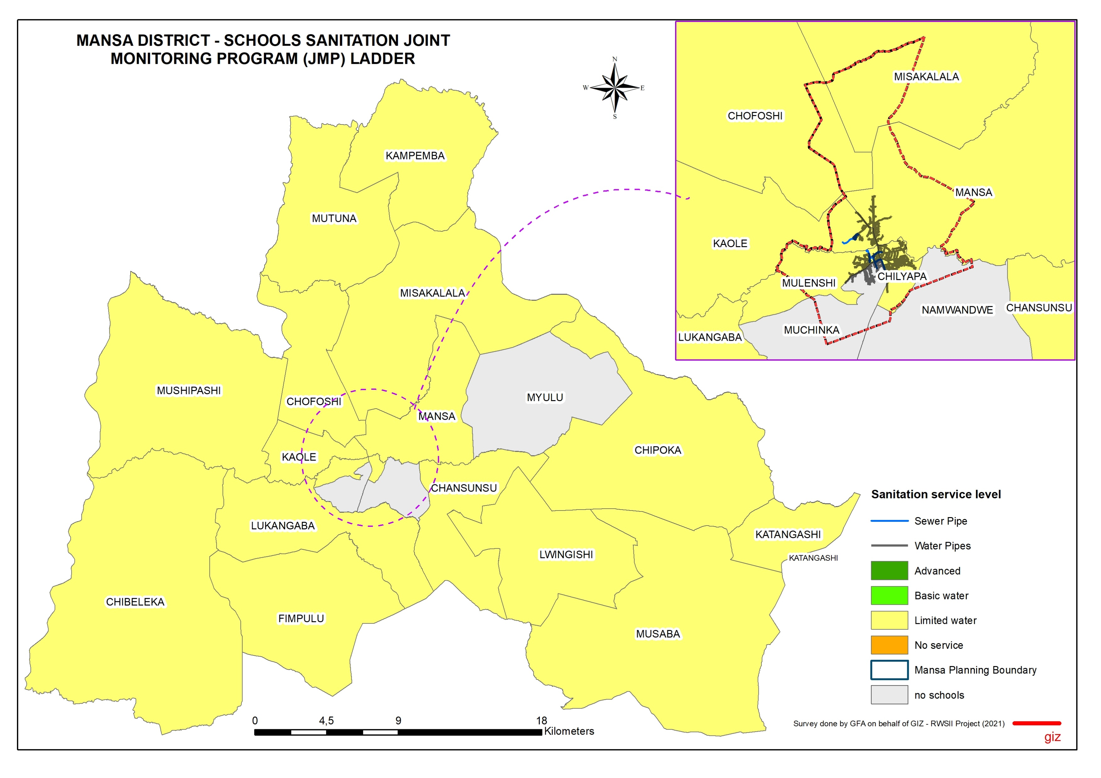
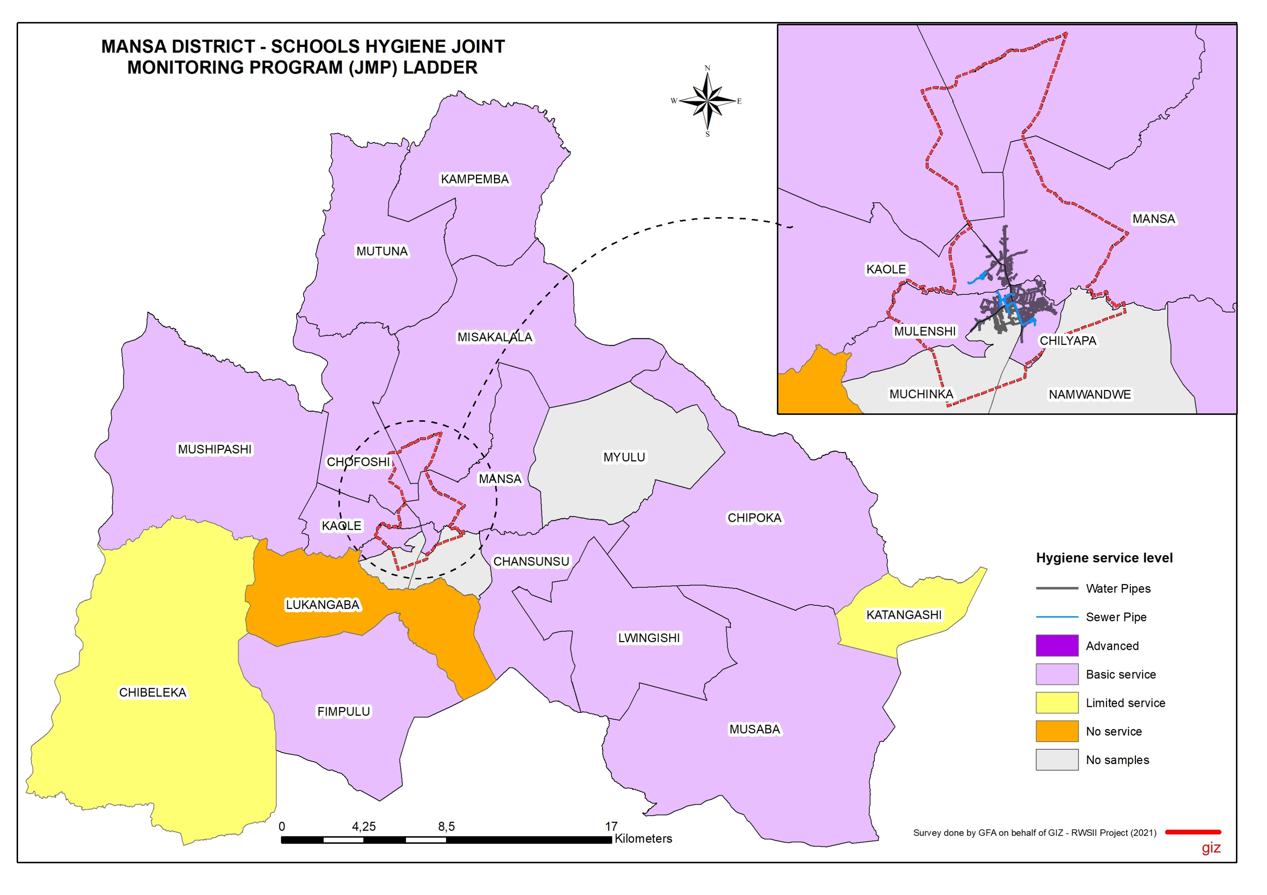




2021 WASH Baseline Mansa District - Schools
ACCESS TO DRINKING WATER
ACCESS TO SANITATION
ACCESS TO HYGIENE
Water Source (%)
Water Continuously Available (%)
Willingness to Connect to LpWSC (%)
Sufficiency of Sanitation Facilities (%)
Sanitation Facilities Usability (%)
Types of hand washing Facility
Availability of Hand Washing Facility
In Mansa District, the main sources of water for schools were boreholes (48%) and wells (31%), with primary and basic schools taking up the largest share of 42% and 28%, respectively. Very few schools are connected to the LpWSC water network.
In Mansa District, the main type of sanitation for schools was Ventilated Improved Pit Latrines (VIPs), followed by improved safe traditional latrines, then waterborne to septic tanks. Very few schools are connected to the LpWSC sewer network. 66% of the schools did not have sufficient sanitation facilities and 97% had usable sanitation facilities.
64% of the schools had continuous availability of water from their water sources.
82% of the schools that were not connected to LpWSC were willing to get connected.
In Mansa District, most of the schools had hand washing facilities (93%) and the majority used tap buckets as hand washing facilities.
DRINKING WATER SERVICE LEVELS (SDG 6.1/JMP LADDER)
SANITATION SERVICE LEVELS (SDG 6.2/JMP LADDER)
HYGIENE SERVICE LEVELS (SDG 6.2/JMP LADDER)
Service level | Definition
Advanced | Safely managed inclusive drinking water: Improved water facilities are located on premises, available when needed, accessible for children with disabilities and free.
Basic | Drinking water from an improved source is available at the school.
Limited | There is an improved source (piped, protected well/spring, rainwater, packaged/delivered water), but water not available at time of survey.
No Service | No water source or unimproved source (unprotected well/spring, surface water).
Service level | Definition
Advanced | The school has improved sanitation facilities at the school premises, which are sufficient, MHM friendly, single-sex, usable and safely managed. Solid waste is frequently collected and/or disposed. Toilet to Pupil Ratio: Boys= 1:25; Girls=1:20
Basic | Improved facilities, which are single-sex and usable at the school Toilet to Pupil Ratio= 1:50
Limited | There are improved facilities (flush/pour-flush toilets, pit latrine with slab, composting toilet), but not single-sex or not usable at time of survey Toilet to Pupil Ratio= 1:100
No Service | No toilets or latrines, or unimproved facilities (pit latrines without a slab or platform, hanging latrines, bucket latrines).
Service level | Definition
Advanced | The school has handwashing facilities with water and soap continually available at critical times. Group handwashing and hygiene promotion is integral part of curriculum and/or school routine Solid waste is frequently collected and/or disposed Handwashing Facility to Pupil Ratio - Boys= 1:25 Girls=1:20
Basic | Handwashing facilities, which have water and soap available. Handwashing Facility to Pupil Ratio= 1:50
Limited | Handwashing facilities with water, but no soap.
No Service | No handwashing facilities at the school or handwashing facilities with no water.
Mansa | Drinking Water
 | Primary | Basic | Secondary | Combined | Other
Advanced | 19% | 20% | 30% | 60% | 50%
Basic Service | 12% | 30% | 60% | 20%
Limited Service | 38% | 25% | 10% | 20% | 17%
No Service | 31% | 25% |  |  | 33%
Total | 100% | 100% | 100% | 100% | 100%
Mansa | Sanitation
 | Primary | Basic | Secondary | Combined | Other
Advanced Service |  |  | 0.2
Basic Service | 4% | 5% | 20%
Limited Service | 92% | 95% | 50% | 100% | 100%
No Service | 4% |  | 10%
Total | 100% | 100% | 100% | 100% | 100%
Mansa | Hygiene
 | Primary | Basic | Secondary | Combined | Other
Advanced Service
Basic Service | 58% | 85% | 90% | 60% | 67%
Limited Service | 35% | 10% |  | 40% | 17%
No Service | 8% | 5% | 10% |  | 17%
Total | 100% | 100% | 100% | 100% | 100%
Published by;
Reform of the Water Sector Programme Phase II (RWS II) in Zambia
Compiled by;
Gabriel Chibuye (GIS Expert)

