Slide 1
Info session on GIZ new process
New invoicing for GIZ from 2026
due to GIZ system conversion to SAP S/4HANA
27th of January 2026

Slide 2
Agenda
Introduction
First disbursement request
Settlement process
Disbursement request
Payment

Slide 3
introduction

Slide 4
Digital transformation at GIZ
Standardization of business processes
Harmonization of GIZ's IT landscape worldwide
Integration of
GIZ headquarters
country offices
Service unit
increasing efficiency
Compliance to the law

Slide 5
Business partner = contribution recipient
No change in contract department:
Local contribution contract: country office
Financing agreement: country office (up to EUR 100,000)
GRANT agreement: Head office Germany
All running contracts:
A new contract number will be sent to each business partner!

Slide 6
First Disbursement request

Slide 7
Request for disbursement
Hand over the disbursement plan before the 1st request
Use the given template
Add:
requested amount
Funding requirement The funding requirement plan must be submitted digitally at the latest with the first payment request!
With 2nd request for disbursement
Add total cost
Add total fund received
reduce invoice complaints and speed up digital processing

Slide 8
settlement process

Slide 9
settlement process
Use template for Settlement
Add all vouchers individually
Cluster by main budget lines
reduce invoice complaints and speed up digital processing

Slide 10
Required documents
All documents need to be sent electronically to fin.processing_LK@giz.de
Attachment to an e-mail
ZIP-folder
File transfer
Original documents
Financial agreement and GRANT: original documents stay with the recipient for any later audit
LCC: all (physical) original documents need to be send to GIZ LK:
Service Unit LK for preliminary check
Forward to Country Office for in-depth checks

Slide 11
Submitting settlement
from 01.01.2026 onwards:
Settlement sheet
Disbursement request
When sending the settlement sheet, please include the GIZ financing agreement number in the subject line of the email and ensure that all relevant information is clearly visible on the settlement sheet, in particular the agreement number – please cc the responsible GIZ technical advisor in your e-mail.
In 2026, due to a large-scale system migration, new processes will be introduced for service contract invoices and there will be new channels for the receipt of all settlements in PDF format.
Settlement sheet to fin.processing_LK@giz.de
Confirmation and approval e-mail received
Settlement cover sheet to invoice_LK@giz.de

Slide 12
Step 1: settlement sheet
Settlement sheet:
GIZ template
As Excel file
all relevant annexes / documents
in pdf format
To email inbox fin.processing_LK@giz.de
CC: GIZ staff who is responsible for the contribution
commercial and technical review
Corrections requested if necessary
GIZ settlement template: Link: Sri Lanka | GIZ

Slide 13
Step 2: payment
Settlement of disbursement
Checked
Approved
Released
E-mail to be received
Request for cover sheet for the checked and approved services
Final expenditure sheet to be submitted as PDF only
email address invoice_LK@giz.de

Slide 14
Disbursement request

Slide 15
Disbursement request
from 01.01.2026 onwards:
Use of GIZ template
After settlement of 80% of previous disbursement (LCC)
FA and GRANT:
1st & 2nd disbursement in accordance with agreement
From 3rd disbursement onwards with financial overview
please include the GIZ agreement number in the subject line of the email and ensure that all relevant information is clearly visible on the template, in particular the agreement number - please cc the responsible GIZ technical advisor in your e-mail.
In 2026, due to a large-scale system migration, new processes will be introduced for service contract invoices and there will be new channels for the receipt of all invoices in PDF format.
Request for disbursement
Request send to invoice_LK@giz.de

Slide 16

Perform service recording
Communication in the event of commercial claims
Process for reductions or incomplete/incorrect documents
Documentation of corrections
Communication channels
In the case of incorrect settlement documents, the "for GIZ" column will be used to document the necessary changes
Communication takes place via the email address from which the settlement document was sent
Preparation and dispatch of complaint letters to the business partner (including settlement sheet)
The business partner will be informed directly via email using Outlook
Clear and traceable communication is crucial for the efficient processing of complaints
and the timely correction of incorrect settlements.
16
Info session on GIZ new process 01/2026

Slide 17
payment

Slide 18
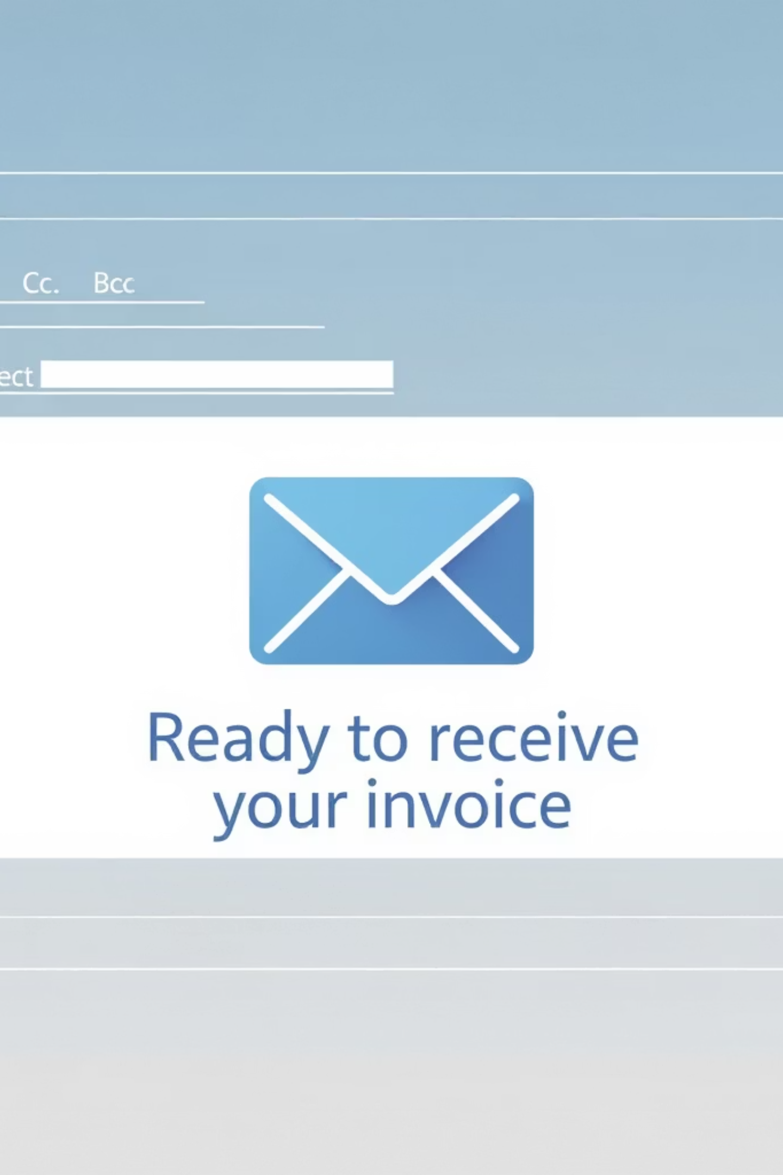
Standard e-mail to the business partner
After the settlement has been approved, a standard email is sent to the contribution recipient. This contains all important information about the approved settlement and the request for payment.
Contents of the standard email
Confirmation of approval of the settlement
Specification of the agreement number and the approved amount
Note on payment request with identical amount
Information on payment receipt (e-mail address)
Contact details for queries
The email to the business partner will always include
the relevant incoming function mailbox in cc
18
Info session on GIZ new process 01/2026

Slide 19
Disbursement request
Verification: agreement compliance and evidence
contractual basis
Compliance processing
Document
We check whether the disbursement has been contractually agreed on and whether all information on the disbursement request sheet is correct.
If the disbursement is in accordance with the agreement and the information is correct, it can be processed and created in the system.
After verification in SAP, the document is stored in the system as disbursement payment as part of the documentation requirement.
Checking agreement compliance is an important step in ensuring that disbursement payments are only made in accordance with the financing agreements.

Slide 20
Questions?

Slide 21
Thank you for your participation
and
support in the transformation process towards digitalizing GIZ

Slide 22
Deutsche Gesellschaft für Internationale Zusammenarbeit (GIZ) GmbH
Registered offices, Bonn and Eschborn
Friedrich-Ebert-Allee 32 + 36
53113 Bonn, Germany
T +49 228 44 60 - 0
F +49 228 44 60 - 17 66
Dag-Hammarskjöld-Weg 1 - 5
65760 Eschborn, Germany
T +49 61 96 79 - 0
F +49 61 96 79 - 11 15
E info@giz.de
I www.giz.de

